Slide 1
Traumatic Brain Injury Survivors: Thinking Deep Through Improved Sleep
James Foster, MS, OTR/L, CBIS.
ReMed
Assistant Clinical Director
Short Term Intensive Rehab System
Notes:
Introduction of self,
Imagine you were a traumatic brain injury survivor. 38 year old male, undergoing rehabilitation on an inpatient basis. And like almost 70% of other survivors, you are having difficulty sleeping, so after only sleeping five hours because of pain from migraine headaches, anxiety (racing thoughts) and depression, you are greeted by OT at 7am.
Time for AM routine which involves paying attention to the cues the OT provides, sequencing, problem solving and not to mention, humility as the 26 year old female OT is seeing you naked, for the first time.
Then breakfast, with the Speech therapist- you have dysphagia so you only get to eat mechanically soft food and honey thick liquids. while SLP is cuing you to “ tuck your chin” “take small bites”. You cant wait until the meal is done, maybe you’ll have time to sleep.
But NO, Here comes the nurse with AM medications. I take them with apple sauce, which I don’t like, but because of my expressive aphasia, I can’t tell them. You figured they’d get the hint after I threw the apple sauce at the nurse, but all they did was increase my Ritalin because my team thought I couldn’t pay attention during sessions, you kept falling asleep.
11am, AHHHHH, nap time, but nope, Psychology. He’s pressing you to talk about my feelings since my car accident. You only use three word responses, at least I don’t cry any more but I want to. Because you’re tired. And you worn out , easily.
Hoping the therapists would just leave you alone, you want to sleep. All you want to do is sleep…… Typical morning of a TBI survivor and the thoughts that are going on in their mind as they consider the challenges.

Slide 2
Sleep?
We spend approximately 36% of our lives doing it.
65 year old, will sleep over 21 years of their life
Rats exposed to environment in which they cannot sleep for days and weeks….die

Slide 3
Why Do We Sleep?
No consensus:
Restoration- sequence of genes turned on while sleeping, genes associated with restoration.(R, Foster, 2013)
--Animals deprived of sleep lose immune /temperature regulation (Hereford, 2014)
Brain/Memory Consolidation- complex problem solving enhanced by a night of sleep (R, Foster, 2013)
Notes:
Because of the inherent difficulty in studying sleep, some of the ideas regarding the function of sleep are speculative.
Some conclusions have been drawn by observing the consequencs of sleep deprivation in both humans and animals..
No one theory will adequately explain the function of sleep, but point to the fact that there are multiple functions.
Restorative: Animals deprived of sleep lose immune function and ability to regulate body temperature, which causes them to die . Also Detramental psychological and behavioral effects with the loss of sleep>
Memory_ Working Memory has been shown to be affected by sleep deprivation.

Slide 4
Why Do Sleep?
Inactivity or Preservation Theory
Brain Plasticity Theory
”Having peace, happiness and healthiness is my definition of beauty. And you can't have any of that without sleep." (Knowles, B 2011)
Notes:
Adaptive or evolutionary process- predator avoidance – survival funcition by keeping the animal safe from attracting attention of predators. ?? More vulnerable???
Brain Plasticity: Sleep is correlated to changes in structure and organization of the brain. Connection to sleep – especially important in infants who spend about 14-16 hours per day sleeping 50% of that is REM Sleep.

Slide 5
What If Not Enough Sleep?
Chemical Plant Disaster in Bhopal, India 1984
Three Mile Island 1979
Chernobyl 1986
Grounding of Star Princess cruise Ship, 2012
Exxon Valdez Oil tanker 1989
Sleep Deprivation of NASA engineers Challenger Shuttle, contributing factor.
Notes:
Some of the most devastatning human and environmental disasters have been linked to sleep deprivation factors.

Slide 6
Attitudes on Sleep
“Sleep is the golden chain that ties our health and bodies together.”
-Thomas Decker
“Enjoy the honey heavy dew of slumbers.”
-Julius Caesar

Slide 7
Attitudes on Sleep
“Sleep is for wimps”.
-Margaret Thatcher
“Money never sleeps.”
-Gordon Gekko

Slide 8
Notes:
Also, older people often sleep less deeply and wake up more often throughout the night, which may be why they may nap more often during the daytime. Nighttime sleep schedules may change with age, too. Many older adults tend to get sleepier earlier in the evening and awaken earlier in the morning.
There are many possible explanations for these changes. Older adults may produce and secrete less melatonin, the hormone that promotes sleep. They may also be more sensitive to -- and may awaken because of -- changes in their environment, such as noise.

Slide 9
International Classification of Sleep Disorders
Insomnia
Sleep Related Breathing Disorders
Central Disorders of hypersomnolence
Circadian rhythm sleep-wake disorders
Parasomnias
Sleep related movement disorders
Other sleep disorders
(ICD 10, 2015)
Cookie iOS
Notes:
Insomnia- A sleep disorder characterized by difficulty in falling and or remaining asleep. 58% of adults in US experience a few nights a week. (National sleep foundation)
Sleep Related Breathing D/O- Sleep apnea, Dyspnea, Hypoventilation
Hyper somnolence _ Sleeping too much
Sleep wake disorders: Researchers believe that two body systems -- the sleep-wake process and our circadian biologic clock -- regulate our sleep. They program our bodies to feel sleepy at night and awake during the day.
The sleep-wake process works by balancing the amount of sleep a person needs based on the time spent awake. Our circadian biologic clock is a 24-hour body rhythm affected by sunlight. It regulates hormones such as melatonin, which is secreted during the night and promotes sleep, and other processes like body temperature. Sleeping at a time that is in sync with this rhythm is important for healthy sleep.
Parasomnias- sleep walking, sleep eating sexsomnia, bruxism (grinding teeth), sleep talking, bed wetting, exploding head syndrome ( benign condition person hears loud imagined noises, bomb, gunshot)
SR Movement disorders- restless legs syndrome
Other: night terrors,

Slide 10
Sleep Architecture
Notes:
REM (rapid eye movement) Mammalian sleep characterized by random movements of the eyes, low muscle tone and deeper sleep.

Slide 11
Role of Melatonin
Suprachiasmatic nuclueus
Controls body temperature
Initiates Pineal Gland to make Melatonin
Inactive during day time
When sun sets, darkness occurs and melatonin is produced and released in blood.
Bright light directly inhibits the release of melatonin. (phone?)
Only hormone that can be bought over the counter without prescription
Hormonal assister in light/dark signals
Notes:
Melatonin is a natural hormone made by your body's pineal (pih-knee-uhl) gland. This is a pea-sized gland located just above the middle of the brain. During the day the pineal is inactive. When the sun goes down and darkness occurs, the pineal is "turned on" by the SCN and begins to actively produce melatonin, which is released into the blood. Usually, this occurs around 9 pm. As a result, melatonin levels in the blood rise sharply and you begin to feel less alert. Sleep becomes more inviting. Melatonin levels in the blood stay elevated for about 12 hours - all through the night - before the light of a new day when they fall back to low daytime levels by about 9 am. Daytime levels of melatonin are barely detectable.
Video production in partnership with
Besides adjusting the timing of the clock, bright light has another effect. It directly inhibits the release of melatonin.
A key factor in how human sleep is regulated is exposure to light or to darkness. Exposure to light stimulates a nerve pathway from the retina in the eye to an area in the brain called the hypothalamus. There, a special center called the suprachiasmatic nucleus (SCN) initiates signals to other parts of the brain that control hormones, body temperature and other functions that play a role in making us feel sleepy or wide awake.
The SCN works like a clock that sets off a regulated pattern of activities that affect the entire body. Once exposed to the first light each day, the clock in the SCN begins performing functions like raising body temperature and releasing stimulating hormones like cortisol. The SCN also delays the release of other hormones like melatonin, which is associated with sleep onset, until many hours later when darkness arrives.
1
2
3
›
last »

Slide 12
Sleep and TBI
Sleep disorders are three times more common in TBI survivors compared to the general population and nearly 60% of TBI survivors experience long term sleep difficulties. (MSKTC,2010)

Slide 13
Causes of Sleep Disorders Within TBI Population
Pain
Depression
Altered Sleep/Wake Cycle
Notes:
Pain: TBI: Headache pain, orthopedic pain, contracture pain,, heterotopic ossification (51-77.9%) VA, JAMA, 2008)
Depression/Anxiety substantial influence on sleep quality/ hyper somnulence? (Viola-Saltzman and Watson
60-80% Depression report fragmentd sleep, (initial insomnia/early morning awakenings, 15-20% report hypersomnia) (DeMartinis, and Winokur, 200&)
Sleep wake cycle: Our brain s internal clock controls when we sleep.wake and if injured, messages that need to be provided by our brain is altered. Brain chemistry can also be altered post traumatic hypersomnia (Sleep more hours than normal)

Slide 14
PTSD in Veterans
“Our results highlight the importance of sleep disturbance as a factor contributing to cognitive outcome in individuals with posttraumatic stress disorder symptoms. They point to the importance of considering sleep problems in the diagnosis and treatment of cognitive deficits in veterans with blast exposure.”
J Head Trauma Rehabil. 2016 Sep-Oct;31(5):309-19. doi: 10.1097/HTR.0000000000000197.
Self-Reported Sleep Disturbance Mediates the Relationship Between PTSD and Cognitive Outcome in Blast-Exposed OEF/OIF Veterans.
Verfaellie M¹, Lee LO, Lafleche G, Spiro A.
Notes:
Increased posttraumatic stress disorder symptomatology was associated with worse performance in multiple cognitive domains. This association was mediated in part by self-reported sleep disturbance.

Slide 15
Causes of Sleep Disorders Within TBI Population
TBI Related Medications
Racing Thoughts
Sleep Apnea
Urinary Incontinence
Sexual Dysfunction
Notes:
Stimulants such as Adderall and Ritalin to assist with attention. Are commonly used however will also make sleep more difficult.
Sleep apnea (breathing interuppted duing sleep, Sometimes brains ability to control breating becomes altered, resulting in periods of apnea, Oxygen levels drop, also if family history or obesity
Urinary Incontinence-Urinary Incontinence. Urinary incontinence after brain injury can be caused by injury to areas of the brain involved in the motor regulation, or sensory awareness, of urinary function. It can also be secondary to damage of peripheral nerves caused by trauma or downstream biochemical effects of brain injury.
Sexual Dysfunction. There are multiple brain systems involved in sexual response and function, from reflex centers involved in arousal, to higher cortical centers involved in sensory and emotional aspects of sexual contact. Any of these systems can be compromised by brain injury, resulting in problems in sexual function ranging from physical issues, to disinhibition and dysregulation of sexual impulses.

Slide 16
So What?
Clear positive relationship between quality of sleep, language processing, attention and memory in TBI. (Wiseman-Hakes, C et al, 2011)
Persistent Sleep Disturbances Independently Predict Poorer Functional and Social Outcomes 1 year after Mild TBI ( Chan and Feinstein, 2015)
Performance on selected measures of cognitive functioning significantly improved with improved sleep disturbance after TBI. (Mahmood, et al , 2005)

Slide 17
Sleep/Cognition Literature
Prefrontal cortex and temporal lobe in sleep deprived brain shows increased activity during performance of simple verbal/language processing tasks (Science Daily, 2000)
Attention and reaction time impaired in sleep deprived subjects using psychomotor vigilance task (press button in response to a light stimulus) (Van Dongen, et al, 2002)
Notes:
Sleepier the brain is, the greater the Pre Frontal cortex must work. Brain is compensating for the negative effects of sleep deprivation, Temporal lobe (language procesing)

Slide 18
Impact of Sleep Disorder
Attention
Memory
Visual Processing
Cognitive Fatigue

Slide 19
Impact of Sleep Disorder
Lower Seizure Threshold
Delusions
Hallucinations
Increased risk of depression
Irritability

Slide 20
Pharmacological Sleep Interventions
SARI: Serotonin Antagonist and Re Uptake Inhibitor
Alter levels of Serotonin in brain, to treat depression and in low doses used as a sleep aid (Trazadone)
Atypical (Sec Gen) Antipsychotic – treat psychiatric conditions,(mood swings, disordered thinking and behavior) block receptors in brain’s dopamine pathways – Side effect- Drowsiness/fatigue (Seroquel, Risperdal, Geodon)
Non Benzodiazepines- treatment of insomnia, originally thought to be less addictive then benzodiazepines- but can be habit forming (Ambien, Lunesta, Sonata)
Notes:
Architecture of SARI: Can cause increased sleepiness, increased daytime sleepiness, suppress REM sleep. Decreased sleep effeciency.
Atypical: Less likely to cause motor control disabilities, body rigidity. Tremors, Parkinsons’s like movements.. These can become permanent even after medication is stopped

Slide 21
Interdisciplinary Interventions to Improve Sleep
Education on Sleep Hygiene
Environmental Modifications
Temperature??
Dietary Considerations
The Cool Side
Notes:
Role of sleep and it’s importance. Use of schedules and reminders. (ACRM approach with orientation sheet- sleep hygiene interventions listed on schedule)
Environmental modifications- Dark and cool room. Recommended bedroom temperature between 60-67 degrees Our bodies temperatures drops, if room is cool, this process occurs quicker (2016 sleep.0rg)
Positional- Stay out of bed during day- Bed is for two things sleep and _____?

Slide 22
Interventions
Relaxation Techniques
Pharmacological Interventions
Scheduling of Medications
Soothing Ocean Sounds

Slide 23
Methods of Collecting Sleep Data
Staff Data Collection Methods
Self Data Collection
Electronic Monitoring

Slide 24
Electronic Sleep Monitoring
Monitors Sleep Through Movement and Heart Rate
More detailed reporting concerning total and types of sleep
Good validity compared to polysomnography. (Zambotti, et al 2015)
Notes:
First, the device must detect when you’ve actually fallen asleep. Most of them do not factor in the time it takes for you to fall asleep. So, whether it takes you 20 minutes to fall asleep or 40 minutes that time is not included in your sleep cycle. Once you’ve stopped moving for a certain length of time and your heart-rate has decreased, the device assumes you are fast asleep.
Once you’ve actually fallen asleep, the device begins to measure a variety of things like heart-rate, movement patterns and velocity of your movements. Altogether, these measurements allow the device to discern how long you’ve been sleeping, and how deep your sleep is. Obviously, light sleep is less beneficial for your body and so the device will let you know when you’re resting time was poorly spent.

Slide 25
Cognitive Measurements
Staff Reports, attention during sessions, irritability (Macro trackers)
MMSE (Mini Mental Status Exam)
MPAI (Mayo Portland Adaptability Index)
RBANS (Repeatable Battery –Assessment of Neuropsychological Status)
Trial Making Test (Working Memory, Visual Attention)
Notes:
MMSE-0/30 Orientation, registration, attn/calculation, recall , language
MPAI- )- None, 1 Mild problem but does not interfere with activities, 2 mild prob interferes with activities 5-24%, 3 Moderate prob 25-75 4 >75.
RBANS- Immediate memory, visual spatial skills, attention and delayed memory
Trail making test neuropsychological test of visual attention and task switching. It consists of two parts in which the subject is instructed to connect a set of 25 dots as quickly as possible while still maintaining accuracy.

Slide 26
Notes:
Average 29 seconds, deficient > 78 seconds,

Slide 27
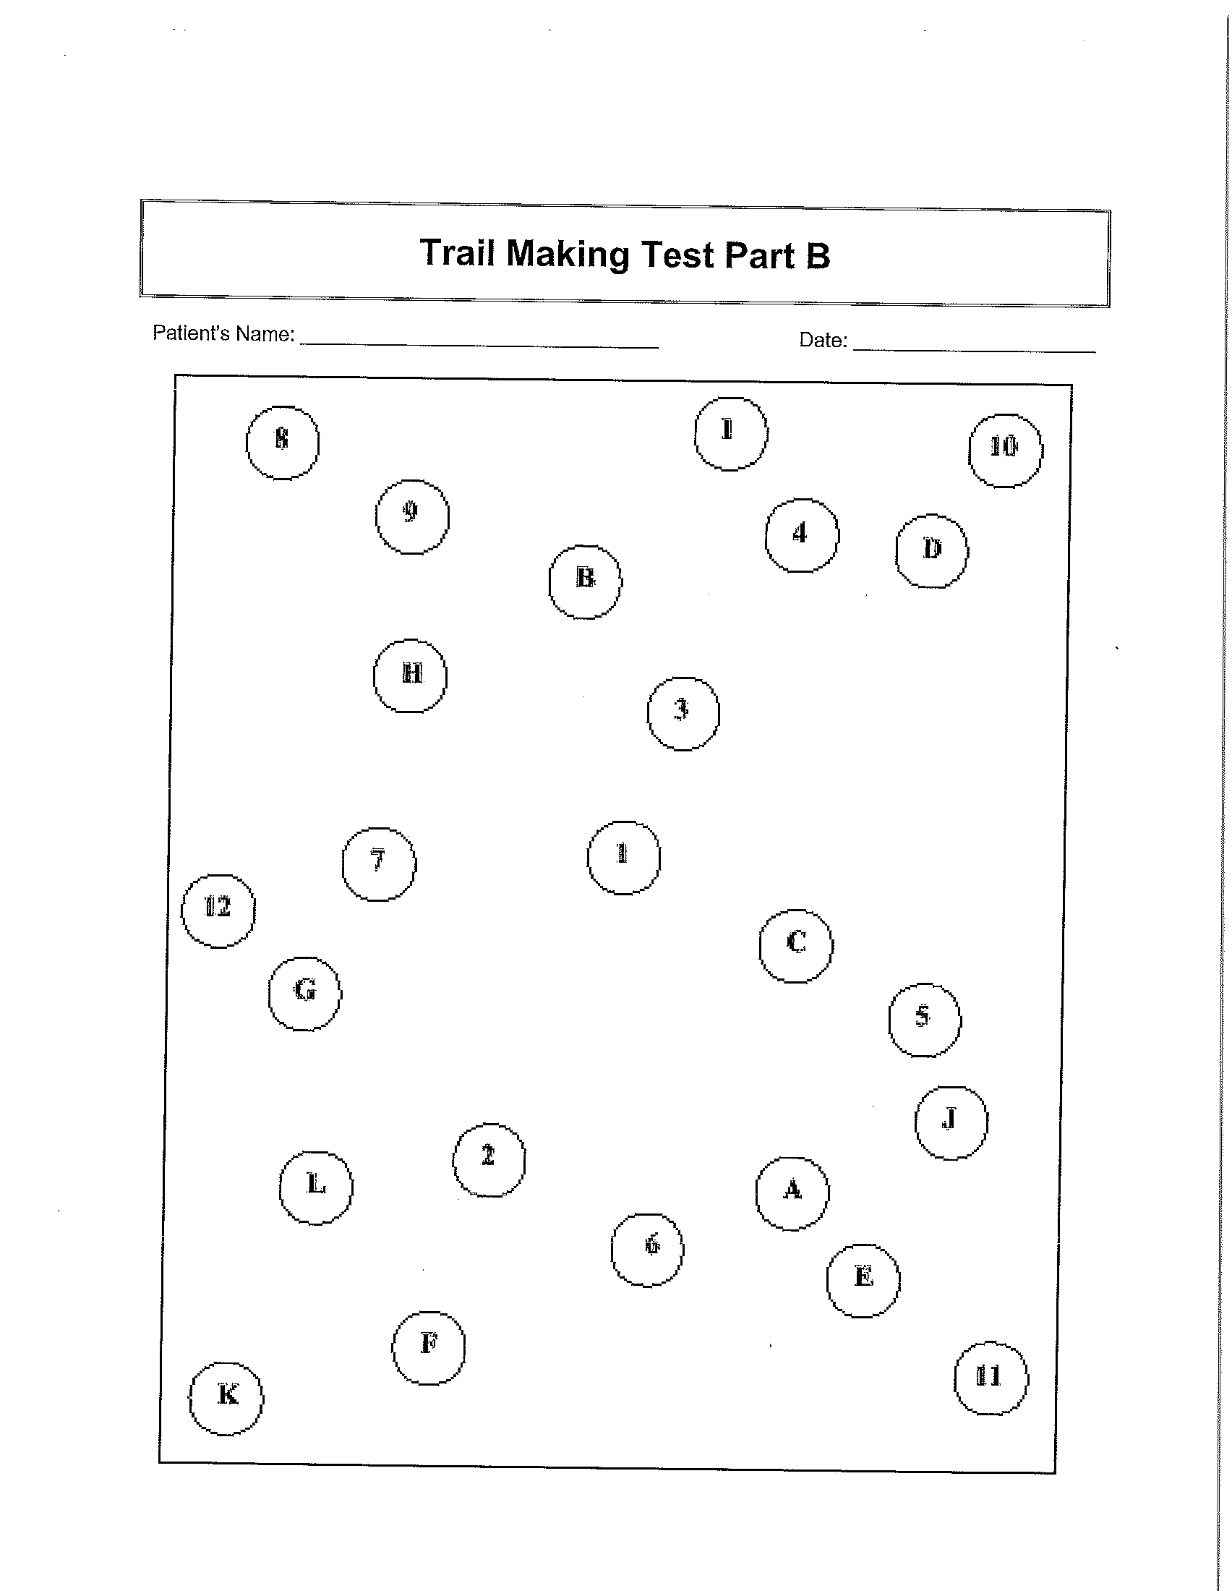
Notes:
Average 75 seconds Deficient > 273 seconds

Slide 28
Case Study
DR is a 46 year old female injured in 11/2015.
Large frontal temporal subdural hematoma
Seizure activity, hemiplegia, and pain issues
Admitted to ReMed in 6/2015 only sleeping an average of 6.5 hours of total sleep daily per staff reporting.
Impaired memory, attention, presence of daily fatigue, easily agitated.

Slide 29
D.R. Continued
Steps Taken
Introduction of Seroquel
Education on Sleep Hygiene
Use of Orientation Sheet
Reminders posted in room

Slide 30
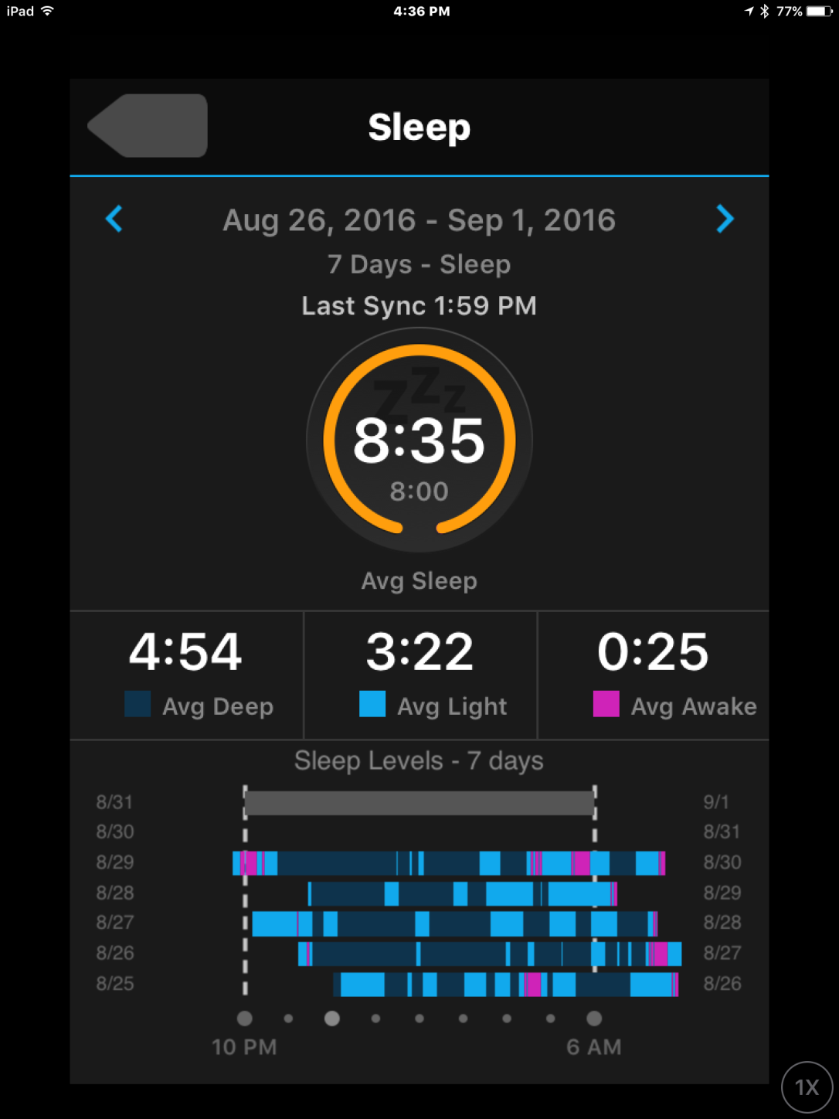
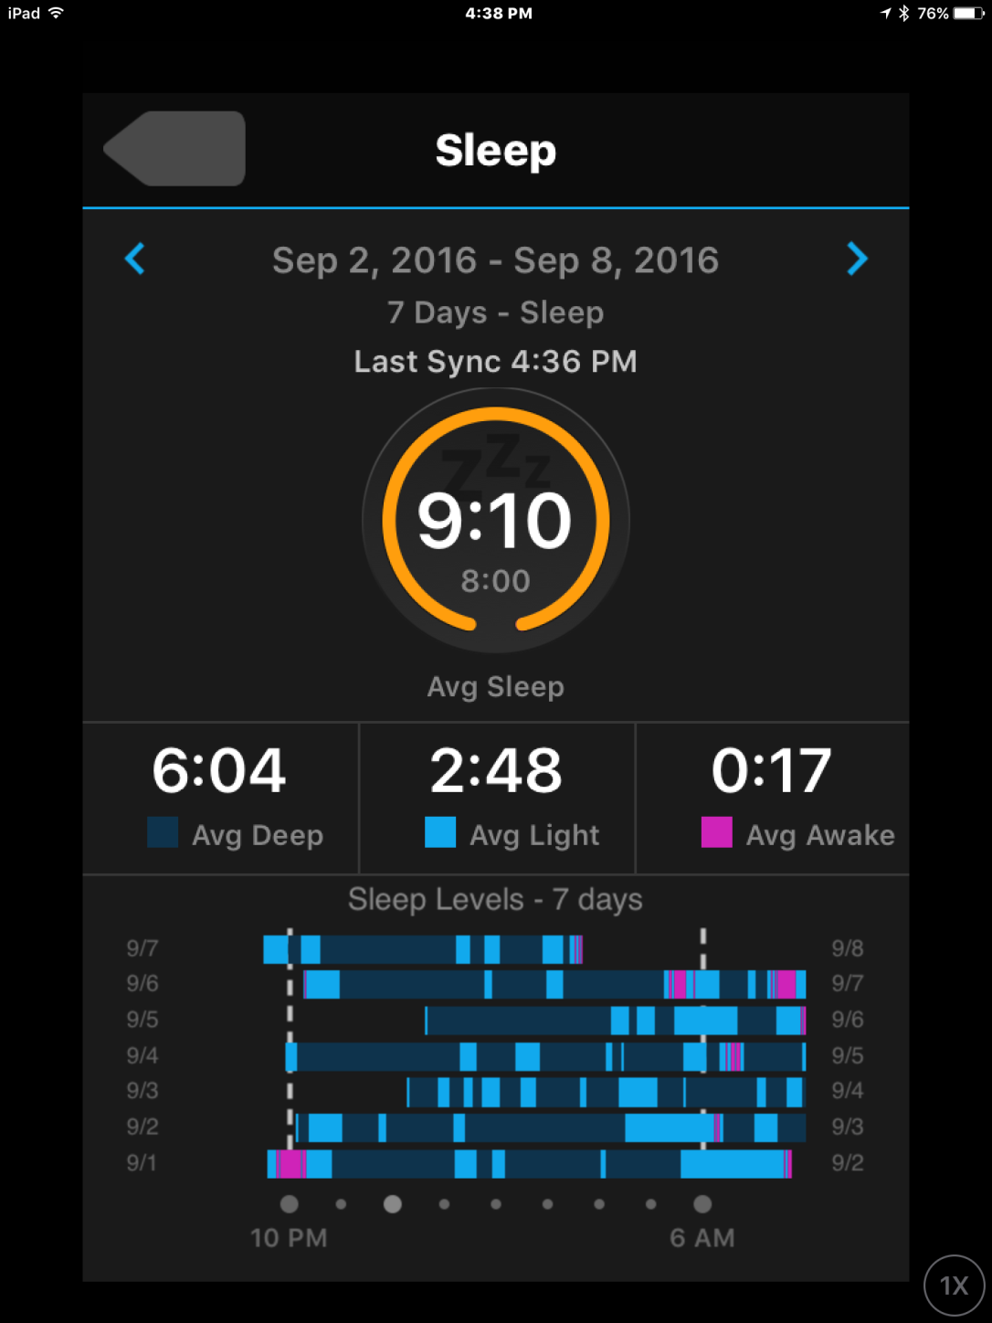

Slide 31
RBANS
RBANS
 | 7/29/2016 |  |  | 9/23/2016
 | Form A |  |  | Form B
 | Index Score | Percentile | Descriptor | Index Score | Percentile | Descriptor
Immediate Memory | 44 | <0.1 | Extremely Low | 57 | 0.2 | Extremely Low
Visuospatial/Constructional | 89 | 23 | Low Average | 92 | 30 | Average
Language | 57 | 0.2 | Extremely Low | 83 | 13 | Low Average
Attention | 75 | 5 | Borderline | 91 | 27 | Average
Delayed Memory | 75 | 5 | Borderline | 60 | 0.4 | Extremely Low
Total Scale | 60 | 0.4 | Extremely Low | 70 | 2 | Borderline

Slide 32
D.R. Cognitive Improvement
MMSE: 7/18/16: 25/30 8/18/16: 27/30
Trails Making Test 7/18/16 A: 1:07 B: 2:39
Trails Making Test 8/18/16: A: 29.23 B: 1:34
PA Drivers Permit Test: 8/18/16: 72% 9/5/16: 94%

Slide 33
References
Brain Injury Association , 1997 (retrieved on August 23, 2016)
Centers for Disease Control and Prevention. (2015). Report to Congress on Traumatic Brain Injury in the United States: Epidemiology and Rehabilitation. National Center for Injury Prevention and Control; Division of Unintentional Injury Prevention. Atlanta, GA.
Chan and Feinstein, (2015) Persistent sleep disturbances independently predict poorer functional and social outcomes 1 year after mild TBI, J head Trauma Rehabil. 30 E67-E75)
Hereford, J. Sleep and Rehabilitation. A Guide for Health Professionals,. Slack Inc. 2014.
Massimiliano de Zambotti, PhD,1 Fiona C. Baker, PhD,1,2 and Ian M. Colrain, PhD1,3 (2015) Validation of sleep tracking technology compared to polysomnogragpy in adolescents. Sleep 1461-1468.
Model Systems Knowledge Translation Center, 2010 Sleep and Traumatic Brain Injury
Wiseman-Hakes, Victor, JC, Brandys, C, , Murray, BJ (2011) Impact of post traumatic hypersomnia on Functional recovery of cognition and communications , Brain Injury 2011 1256-65
Turner, TH, Drummond, SPA, Salam at, JS, Brown GG, Effects of 42 hour sleep deprivation on component processes of verbal working Memory. Neuropsychology. 2007.
Verfaellie M¹, Lee LO, Lafleche G, Spiro A J Head Trauma Rehabil. 2016 Sep-Oct;31(5):309-19. doi: 10.1097/HTR.0000000000000197.
Self-Reported Sleep Disturbance Mediates the Relationship Between PTSD and Cognitive Outcome in Blast-Exposed OEF/OIF Veterans.

Slide 34
Questions?
ZZZZZZZZZZZZZZZZ..

