Slide 1
De-Escalation Techniques:
De-escalation techniques used with the brain injury population in an acute/chronic inpatient setting
Dan Gladmon, MPT
Candace Rebuck, CTRS, CBIS

Slide 2
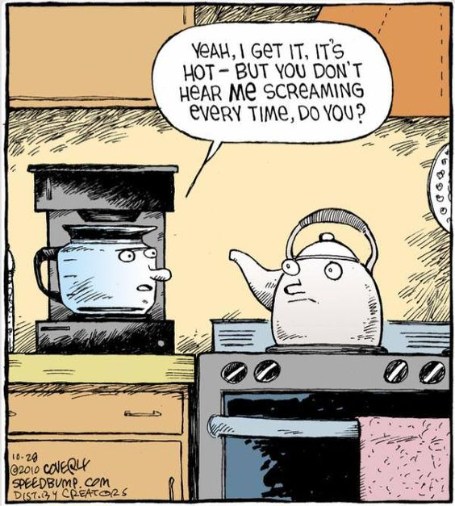

Slide 3
Definition of Agitation:
A state of excessive psychomotor activity accompanied by increased tension and/or irritability.

Slide 4
Signs of agitation:
Restlessness
Throwing objects
Verbal abuse
Hitting
Kicking
Running away (eloping)
Extreme lability

Slide 5
Agitation occurs in 70% of TBI patients
Agitation leads to:
  Adverse effects on lengths of stay
  Adverse effects on functional outcomes:
    Longer lengths of stays
    Decreased likelihood to be discharged home
(McNett, M., Sarver, W. and Wilczewski, P. Brain Injury Journal, Volume 26(9), 2012)
Notes:
Agitation occurs in 70% of patients hospitalized with traumatic brain injury (TBI) and has adverse effects on length of stay and functional outcomes.
Agitated patients had longer lengths of stay and were less likely to be discharged home.

Slide 6
Neuroanatomical Correlates of Agitation:
What parts of the brain are in charge of agitation?
Temporal Lobe
Frontal Lobe
Limbic System

Slide 7
Auditory reception
Expressed behavior
Language / Receptive
Memory / Retrieval
Agitation, irritability, and disruptive behaviors
Aphasia
Temporal Lobe

Slide 8
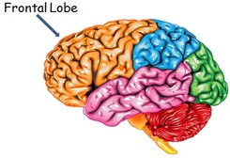
Frontal Lobe
Attention
Motivation
Emotional control
Language
Decision making
Judgment
Problem solving
Notes:
Due to the complex and heterogeneous process of TBI, localizing cognitive behaviors and agitation to specific areas of injury remains elusive
•Posttraumatic agitation may be multi-faceted and likely the consequence of a combination of different lesions and dysfunction in neurotransmitter systems

Slide 9
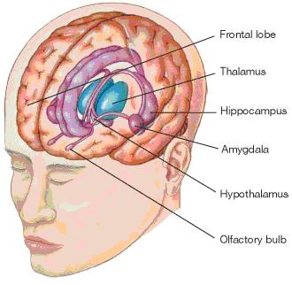
Limbic System
Sex drive
Rage
Fear
Emotions
Recent memories
Smell
Agitation
Loss of control of emotions

Slide 10
Agitation for more than 26 days can lead to:
  Longer inpatient rehabilitation stays
  Lower likelihood to be discharged home
Bogner,JA (2001) American Journal of Physical Medicine Rehabilitation
Notes:
These 2 statistics prove this issue is impactful with LOS, insurance costs and outcome for discharges to the community.
Individuals with TBI who experienced agitation for more than 26 days while in Inpatient Rehabilitation Facilities were more likely to spend longer lengths of time in the rehabilitation hospital and less likely to be discharged home.
Bogner,JA 2001
American Journal of Physical Medicine Rehabilitation.

Slide 11
Techniques are general statements of theories.
People respond differently.
Treatment plans based on direct observation are best.
Determining the triggers of behavior is not easy.
  Confusion
  Unable to communicate
  Irrational
Notes:
De-escalation disclaimer: The techniques are general statements of theories used. Not all people will respond in the same manner and individualize team approach is always the best method. Treatment plans for behavioral impairments are best developed by direct observation and determining the antecedents that may be triggering the behavior, is not always easy or possible with a person who is confused, unable to communicate, or in a state of irrational thought processes.

Slide 12
Identifying the triggers of behavior is important.
The INTEGRATED EXPERIENCE is important.
Behaviors influence behaviors.
Notes:
Learning the precipitating factors is important in de-escalation techniques because of the Integrated Experience. Behaviors influence behaviors.
Staff’s behaviors influence patients, patients influence other patients behaviors, and patients behaviors influence staff.
Story about Norman Smith. Blind patient due to injury, age of 45, high speed MVA vs. tractor trailer while ETOH and multi-substances. Triggered by male staff members, attempts to redirect, enforcement of rules – confiscated cigarettes, and attempts at elopement or “walk outside.” De escalation techniques which worked well with him: established rapport with Neuro psych & TR, therapy outdoors when calm and appropriate – with blind techniques cane and techniques, Reviewing the rules and expectations when calm daily.

Slide 13
Internal Triggers of Behavior
Pain
Mental health problems (dual diagnosis)
Hunger
Temperature
Infection
Toileting needs
Impaired cognitive ability
Impaired communication skills
Loss of self esteem/ loss of control
Poor coping mechanisms
Notes:
Definition of internal-an element that causes or contributes to behaviors coming from inside the body. Story of Jason Singleton. Male, MCC thrown 20 feet from bike, unresponsive at the scene. Pt. was a Rancho III at admission to UMROI, Pt. was often agitated, physically restless, used multiple restraints, not easily re-directable. Numerous codes, long length of stay, and apparent internal triggers. Pt.s impaired cognitive ability and body feelings were high triggers. Pt. had not had a BM in several days and was insistent he was pregnant. Ambulating rapidly in the hallways, unsafely and inquired about him. He was perseverating on being pregnant on one of the rounds while walking with him, grabbed the bladder scanner, and he returned to his room calmly, laid down and we reapplied safety devices with his engagement to check his pregnancy status.

Slide 14
External Triggers of Behavior
Attitudes and behaviors of others.
Stimulus response.
Physical environment.
Value, dignity, and respect.
Notes:
Definition of external factors -an element that causes or contributes to behaviors coming from outside of the body
Attitudes and behaviors of others around the patient.
Stimulus response (behavior occurs as an interaction between the person and his environment)
Physical environment - Noise, temperature, smells, touch, light, taste (all 5 senses)
Level of value, dignity, and respect afforded to people
Story Brittany Tawney – 24 year old woman, assault/fall down the stairs at a “party” ETOH and multiple substances. Pt. physical restlessness, low frustration tolerance, easily agitated. She was ambulatory, non compliance with medical devices and multiple attempts at elopement/smoking in her bathroom. Agitated by multiple staff members and attempted to elope to go see her son. Numerous staff members responded to the code, which ramped her up even more. We did not remove the audience and she escalated and needed assistance to return to her room by numerous staff members.

Slide 15
A Unit Environment System (UES)
Minimize EXTERNAL stimulation
Maintain a CALMING environment
Maximize HEALING
Notes:
Unit Environmental Systems
In our specialized brain injury unit, University of Maryland Rehabilitation & Orthopaedic Institute has good results with minimizing external stimulation and maintaining a calm environment to maximize healing.

Slide 16
Unit Environment System
Red Light Level
Lighting: Dim/Dark Room. NEVER PITCH BLACK (scary and dangerous)
Noise: No noise. Use soft voices when necessary to speak.
Activity level: No activity except for direct medical care and therapeutic interventions.
TV/Video/Music: No TV, video, or music.
Room Décor: No room décor.
Visitors: 2 VISITORS AT A TIME (Hospital Policy also).
Limit interaction to 10 minutes (suggested).
Touch/Handling: Limit touch and handling to medical / safety care.
Notes:
This is our highest level of agitation and attempts to minimize the extra stimulation. Story?

Slide 17
Unit Environment System
Yellow Light Level
Temporarily implement red light restrictions at the first signs of agitation or withdrawal.
Lighting: Dim lighting to normal lighting as tolerated.
Noise: No noise. Use soft voices when speaking.
Activity level: Very limited activity level in room. Use slow motions.
TV/Video/Music: Very limited TV/Video/Music as tolerated.
Room Décor: Small amounts of room décor as tolerated.
Please avoid busy and active posters.
Visitors: 2 VISITORS AT A TIME (Hospital policy too).
Limit visits to 30 minutes (suggested).
Touch/Handling: Limited.
Notes:
Medium light level.

Slide 18
Unit Environment System
Green Light Level
Temporarily implement yellow light restrictions at the first signs of agitation or withdrawal.
Lighting: As tolerated
Noise: As tolerated.
Activity level: As tolerated.
TV/Video/Music: As tolerate.
Room Décor: As tolerated.
Please avoid busy and active posters.
Visitors: NO MORE THAN 2 VISITORS AT A TIME
Touch/Handling: Keep limited to level tolerated by patient.
Notes:
Highest level of stimulation, low level of agitation and stimulation.

Slide 19
By the Initial Plan Of Care meeting, the neuropsychologist has assigned every patient a UES “Light Level” according to their tolerance of sensory stimulation.
Posted on:
  Communication board in documentation room via magnets
  Outside of the patients’ rooms on the doorway trim via magnets
  In the chart via Neuropsychology’s notes
Patients can fall between two “Light Levels”:
  Red/Yellow
  Yellow/Green
Off unit privileges:
  Must be Yellow Light Level or higher/ Special Exceptions
Notes:
We often discuss patients every day on our units for restraints use, sitter use and their level of stimulation. May change daily or as their progression is seen by the team members and neuropsychology. We do not allow family members, or friend to take patients off unit who are red or red yellow.
At the initial plan of care meeting, the team assigns all patients a UES level. It is posted on a communication board and outside the room. Sometimes, the patient may fall within 2 categories. This also impacts our use of sitters, family members taking them off the secured unit to the cafeteria, and having time out doors on a secured court yard or healing garden.

Slide 20
Verbal interventions:
Stay calm.
Isolate the person.
Watch your body language.
Keep it simple.
Use reflective questions.
Use silence.
Watch the quality of your speech.
Notes:
Stay calm. This is easier said than done, especially when the person you are working with is screaming or making threats. Isolate. Clear the area. Audiences watching tend to fuel the fires. Ask for your teams assistance and don’t get caught isolated away from your team in case of your need of help. Body language. Use the supportive stance. Be aware of your space, posture and gestures that may be interpreted as threatening. Make your non verbal behavior consistent with your verbal message. Simple. Be clear and direct with your messages. Avoid jargon or medical terms and choices. When someone is beginning to lose rational control, complex information will increase the anxiety level. Questions. Restate their thoughts in your own words to show, you understand their messages. By repeating or reflecting the message in the form of a question, you give them an opportunity to clarify and see that you care. Silence. This is an effective verbal intervention technique. Silence allows the person time to clarify their thoughts and restate ideas. This often leads to a clearer understanding of the source of conflicts. Quality of speech. Specifically be aware of the tone, volume, and cadence of your speech.

Slide 21
Tips for Crisis Prevention
Be empathic
Clarify messages
Respect personal space
Be aware of your body position
Ignore the challenging questions
Permit verbal venting
Set and enforce limits
Keep your nonverbal cues non-threatening
Avoid overreacting
Use physical techniques as last resort (only if your team is trained.)
Notes:
Empathic. Try not to judge or discount the feelings of an other. Clarify. Listen for the root of the problem or the facts. Ask reflective questions and use restatements and silences. Respect. Stand at least 1.5 feet from the escalating person. Moving too close may increase anxiety or lead to acting out behaviors. Body position. Standing eye to eye and toe to toe with someone maybe interpreted as a challenge. Use the supportive stance which communicates respect, coveys a nonthreatening or nonchallenging position, and maintains person safety. Ignore. When someone challenges your authority or a policy, redirect the attention to the issue at hand. Avoid a power struggle. Venting. Allow the release via verbal venting as much as possible to expel extra energy. Calmly state directives and reasonable time limits. Enforce. If a patient becomes belligerent, defensive or disrup0tive then clearly and concisely state limits and directives. Calmly offer choices and consequences. Non threatening. The more someone loses control, the less the person is listening to your words. More attention is paid to your nonverbal communications. Be aware of gestures, facial expressions, movements, and tone of voice. Overreacting. Remain calm, rational, and professional. Your responses will directly affect the agitated person’s behavior. Last resort only. Use the least restrictive method of intervention needed. Physical techniques are to be used only when a patient/student is a danger to themselves or someone else. Only when trained to do so.

Slide 22
Maintain Rational Detachment
The ability to manage your own behavior and attitude.
Do not take the interactions personally.
Notes:
Discussion: Stay calm. We may not be able to control all the predicating factors but we can control our own response to agitation. Helps us maintain professionalism so that staff can manage the situation by responding appropriately.
Maintain Rational Detachment
Definition is the ability to manage your own behavior and attitude.
Not take the interactions personally.
Find positive outlet for the negative energy that can be absorbed.

Slide 23
If you or your facility/ school is interested in learning:
Non Violent Crisis intervention – CPI https://www.crisisprevention.com/
CESA http://www.cesa2.org/programs/nvci/
Handle with Care Behavioral Management System http://handlewithcare.com/?gclid=CNvZ3tvYx9ICFYmPswodYSkDMQ
Notes:
If you or your facility/ school is interested in learning Non Violent Crisis intervention – CPI. https://www.crisisprevention.com/
Instructor training is a 4 day program. Certified to teach in your hospital or school as a day and a half class for staff members and a 4 hour refresher for renewal every 2 years.

Slide 24
Resources:
Nonviolent crisis Interventions Foundation course. Crisis Prevention Institute. Milwaukee, WI.
McNett, M., Sarver, W. and Wilczewski, P. Brain Injury Journal, Volume 26(9), 2012
McNett, M., Sarver, W. and Wilczewski, P. Brain Injury Journal, Volume 26(9), 2012

