Slide 1
Innovative Use of Omega-3 Fatty Acids in Brain Trauma
Michael Lewis, MD, MPH, MBA, FACPM, FACN
Colonel (Retired), U.S. Army
a 501(c)(3) nonprofit organization
Brain Injury Association of Maryland, 23 Mar 2017

Slide 2

If you have a brick wall that gets damaged…

Slide 3





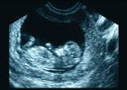
Omega-3: Important Thru-out Life
Pregnancy
Infants & Children
Children & Adults
Adults
Maternal Health
& Outcomes
• Promotes maternal DHA status
• Increases DHA content of breast milk
• Supports normal gestation period
• Promotes fetal brain and eye development
Brain & Eye
Health & Function
  • Less cognitive decline
  • Lower risk of dementia
  • Lower risk of age-related macular degeneration
Brain Development
& Function
  • Improves visual acuity
  • Promotes Cognitive performance
Cardiovascular
Heart Health
  • Lowers triglycerides
  • Increases HDL
  • Improves blood vessel function
Source: Martek BioSciences

Slide 4
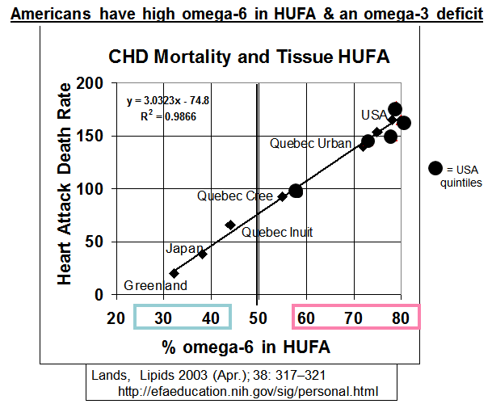
Americans have too many omega-6s
& a relative deficit of omega-3s

Slide 5
Oilseeds in the US Food Supply
Blasbalg et al., Am. J. Clin. Nutr. 93: 950–962, 2011
n6 = 8% Energy
12
10
Soybean
8
Cottonseed
Corn
6
Olive
Disappearance (kg/person/y)
Coconut
4
n6 = 1% Energy
2
0
1909
1919
1929
1939
1949
1959
1969
1979
1989
1999
Year

Slide 6
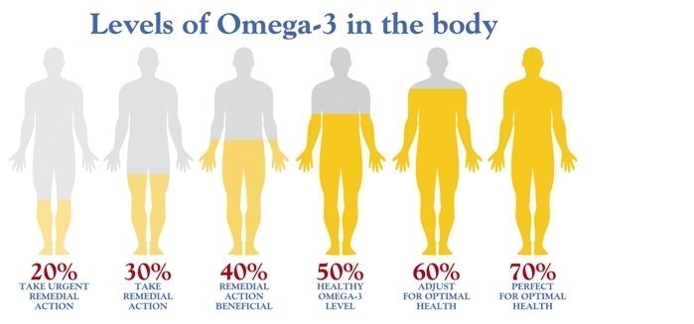

Blood Levels of Omega-3s and Health
17%
US MILITARY
ACTIVE DUTY
20%
TAKE URGENT REMEDIAL ACTION
30%
TAKE
REMEDIAL ACTION
40%
REMEDIAL ACTION
BENIFICIAL
20%
TAKE URGENT REMEDIAL ACTION
30%
TAKE
REMEDIAL ACTION
40%
REMEDIAL ACTION
BENEFICIAL
50%
HEALTHY
OMEGA-3 LEVEL
50%
HEALTHY
OMEGA-3 LEVEL
60%
ADJUST FOR OPTIMAL HEALTH
70%
OPTIMAL HEALTH

Slide 7
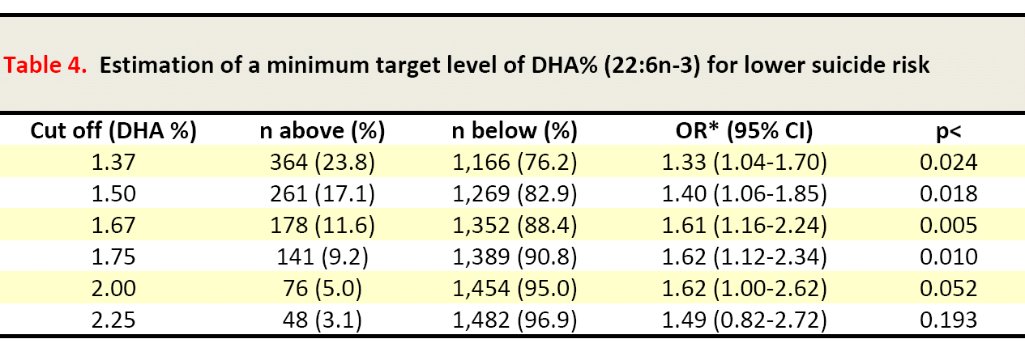

Increased Risk of Suicide Death Among
Active Duty US Military with DHA Deficiency
We looked for logical cutoff that is easily measure with drop of blood
In 95% of the 1,600 samples, DHA levels were below 2.0%
Those subjects represent a 62% increased risk of suicide
Similar DHA levels found in BCT in study by Johnston et al in Iraq
DHA levels can be easily increased for PENNIES a day
Lewis MD, Hibbeln JR, et al. J Clin Psychiatry (August 2011)

Slide 8
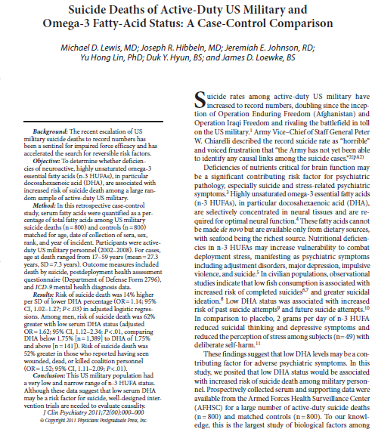

Slide 9
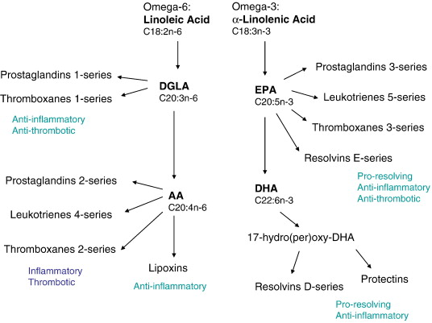
Why are low n-3 levels a concern in TBI?

Slide 10

How Big is the Problem?

Slide 11
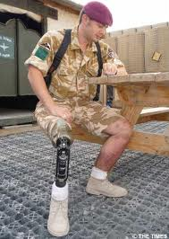
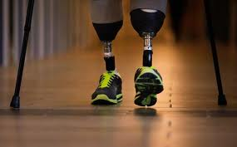
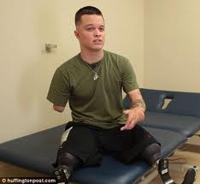
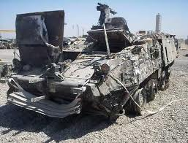
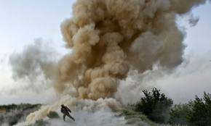
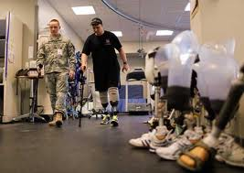
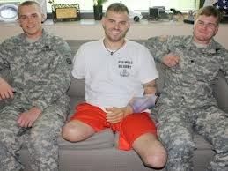
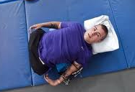
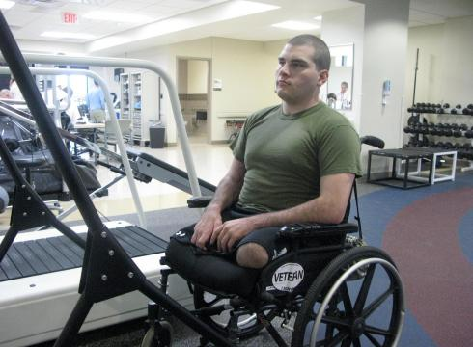
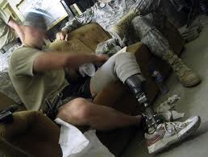
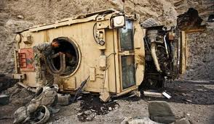
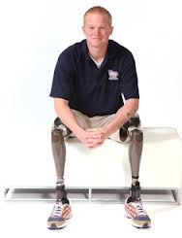
A Decade+ of Military Experience
The visible wounds of war

Slide 12
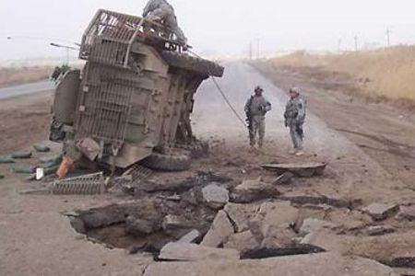
What about the invisible wounds?

Slide 13
Causes of Brain Injury
Traumatic Brain Injury
  TBI
  Sports concussions
  IED blast exposure
  Car accidents
  Falls
  Other blunt trauma
Stroke
Anoxia – lack of blood to brain
  Heart attack
  Surgery
  Near drowning
Chemotherapy

Slide 14
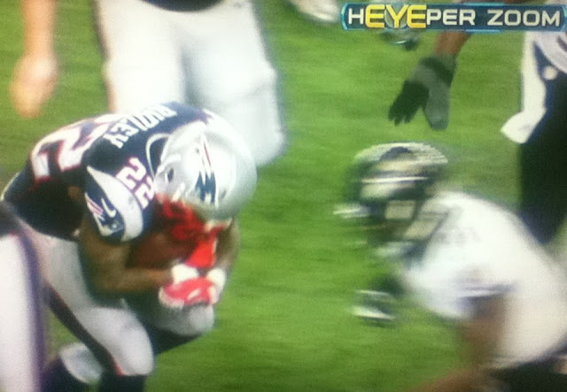
Concussion in Today’s Sports:
44 million kids play organized sports
At least a million treated for TBI yearly
Players are bigger, faster, stronger
Athletes are motivated to play through injury for a variety of reasons
Concussion remains an “invisible” injury

Slide 15



Slide 16
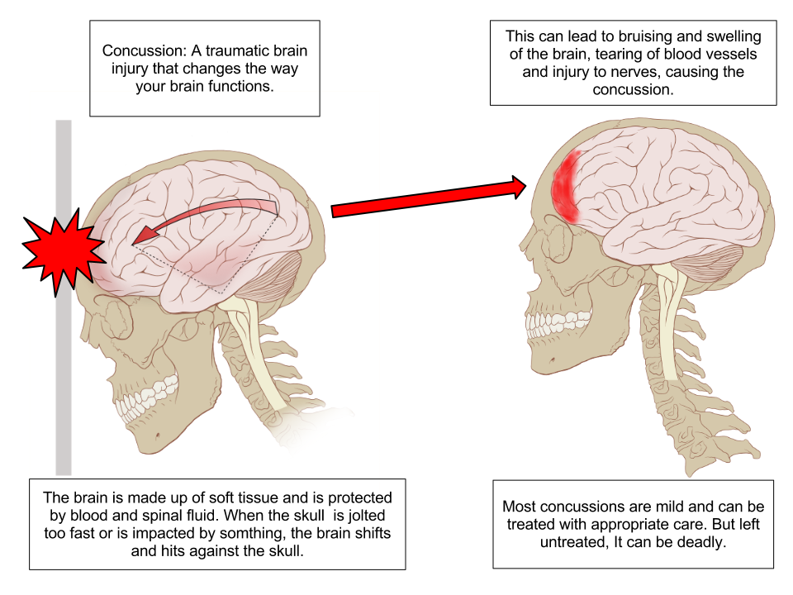
Concussion: a complex pathophysiological process affecting the brain, induced by traumatic forces

Slide 17
CT Scan right after a severe TBI – contusions and bleeding present, no DAI apparent

Slide 18
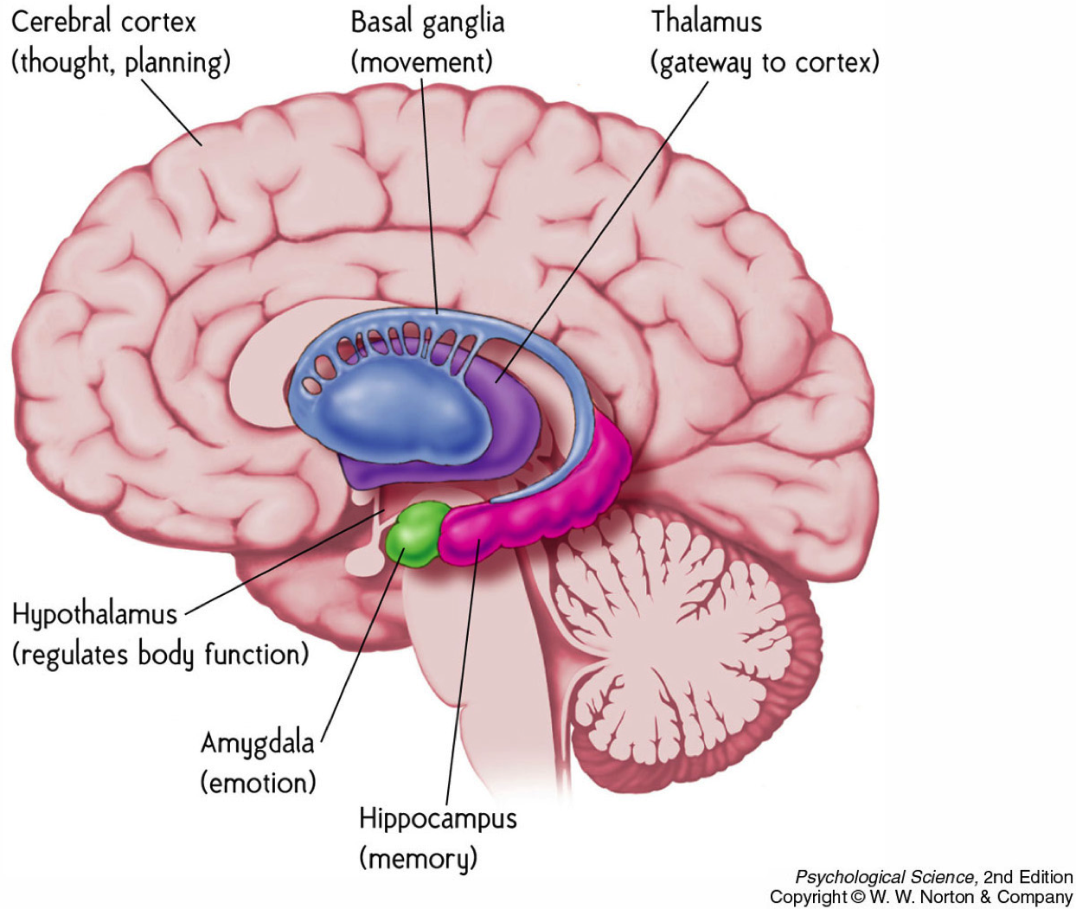

Slide 19
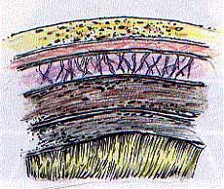
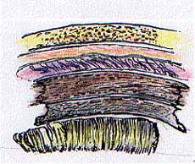
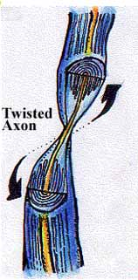
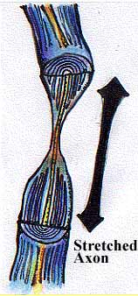
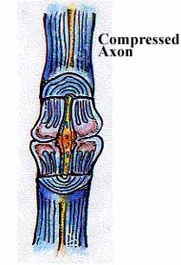
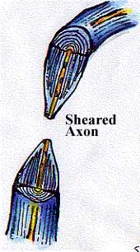
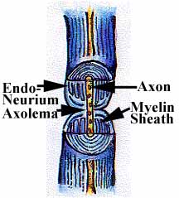
Diffuse Axonal Injury to Neurons
Primary pathological feature in all levels of brain injury
Functional injury
Not detectible on CT
Decreased brain arousal & function
Healthy
Shearing
DAI Injured Neurons
Healthy Neuron

Slide 20
Time
Seconds
Minutes
Hours
Days
Weeks
Months
Primary
Injury from
Impact
Vascular Injury
Contusion
Neuronal Injury
Axonal Injury
Biochemical
Cascades
Biochemical
Cascades
Edema and
Swelling
Metabolic Disruptions
Inflammation
Continued Cellular Damage
Necrosis Apoptosis
Continued damage following initial injury

Slide 21
MRI one week later…DAI present

Slide 22
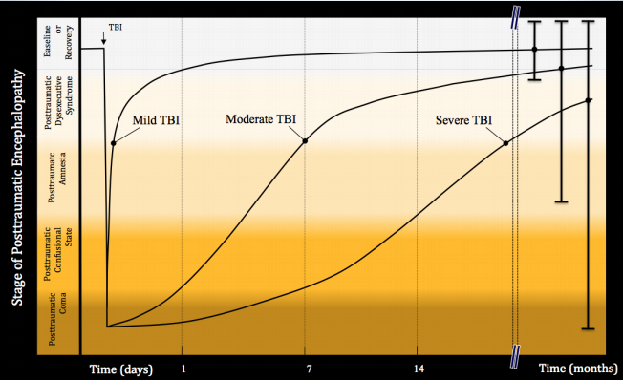
Typical Courses After TBI
Arciniegas DB, McAllister TW. Cognitive Impairments. In Arciniegas DB, Zasler ND, Vanderploeg RD, Jaffee MS (editors): Clinical Manual for the Management of Adults with Traumatic Brain Injury. Washington DC, American Psychiatric Publishing, Inc. 2013, pp.131-164.

Slide 23
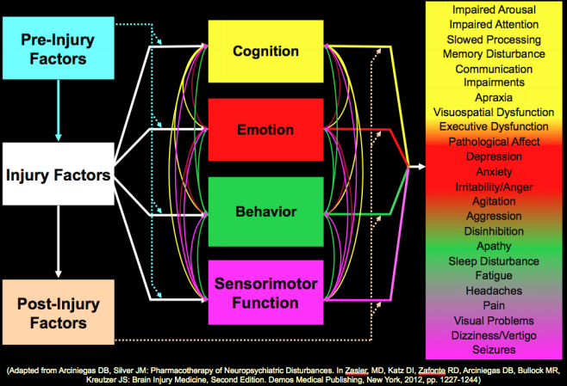

Slide 24
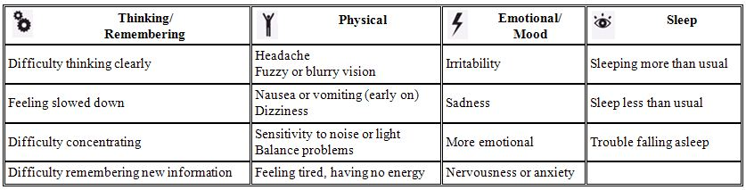

Symptoms Following Brain Injury

Slide 25
New Concussion Score for Children Flags Higher-Risk Cases
12-point clinical score for children
Researchers looked at more than 70 possible variables and found 9 assoc w/ long term sx
Female sex (2 pts)
Age >12 (2 pts)
Fatigue (2 pts)
Migraine history
Previous concussion with sx >1 week
Headache
Sensitivity to noise
Answering questions slowly
Balance errors >4
12 points possible
9-12 points: high risk
0-3 points: low risk
93% specificity
0-3 -------- 6 -------- 9-12
3x less/more likely to have persistent issues
JAMA, 8-Mar-2016: www.medscape.com/viewarticle/860132

Slide 26
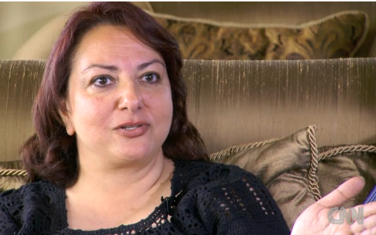
What do we do after an injury?
Mom of 18-yo TBI pt on CNN’s Sanjay Gupta MD show: “He lived, he survived, and now what?”
The problem is:
there is nothing
“The art of medicine consists of keeping the patient amused while nature heals the disease.”
François-Marie Arouet (1694 - 1778)

Slide 27

CDC: “Treatment” for TBI
These recommendations are being questioned

Slide 28
Joel Goldstein, No Stone Unturned:
A Father's Memoir of His Son's Encounter with Traumatic Brain Injury
“Even the best-trained, most skilled, and well-intentioned professionals in the world often suffer a kind of tunnel vision, sticking to familiar, well-trod paths that pioneers once blazed.”
“Conventional medicine only takes survivors of TBI so far…. Unconventional therapies are not merely a reasonable option, they are a necessity.”

Slide 29

What Do Animal Studies
Teach Us About the Use of Omega-3s for Brain Injury?

Slide 30
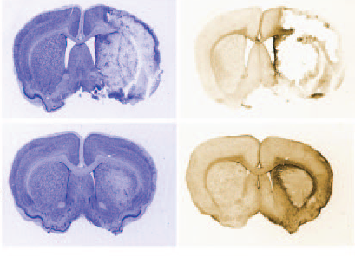
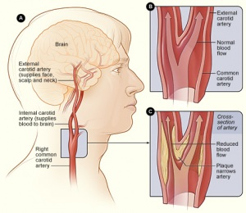
Treatment: DHA Provides Neuroprotection
Protects brain from necrosis after stroke
Administered 3 hrs after middle cerebral artery ischemia for 30 mins
No
DHA
With
DHA
Counter stain
Glial stain
Belayev et al Stroke (2009)40;3121–3126

Slide 31
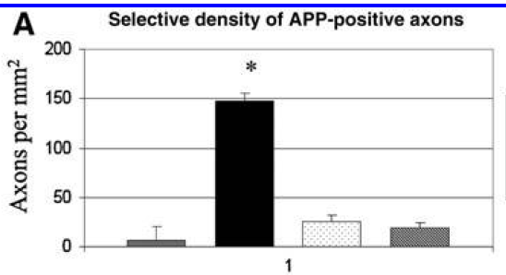
DHA Treats Weight Drop Head Injury
Treatment with DHA for 30 days after TBI
Injury
+
10 mg/kg
DHA
Injury
+
40 mg/kg
DHA
No
Injury
Injury
Bailes JE and Mills JD. DHA Reduces Traumatic Axonal Injury in a Rodent Head Injury Model. J Neurotrauma (2010)27:1617–1624

Slide 32
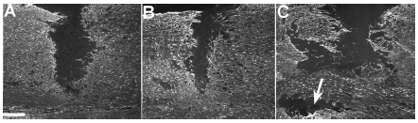
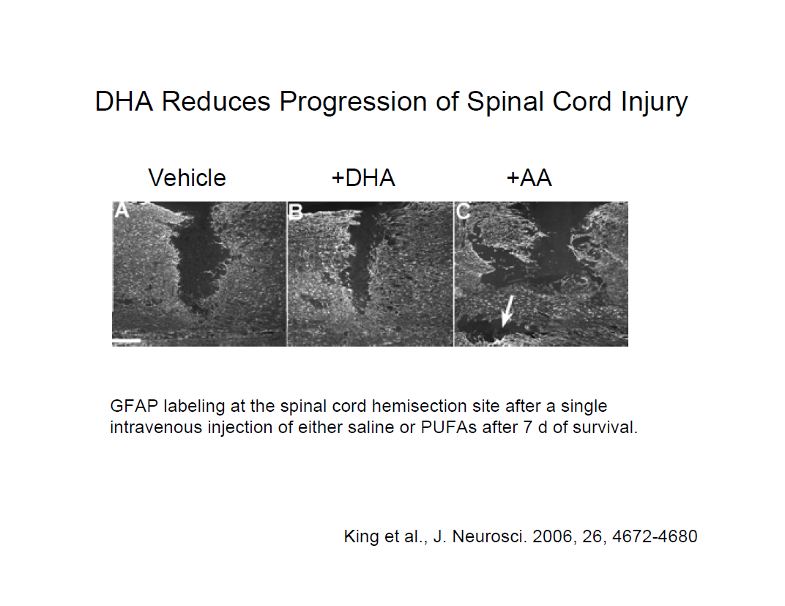
DHA Reduces Progression of
Spinal Cord Injury
Intravenous administration 1 hour after injury
No DHA
DHA
Omega-6 ARA
NOTE: The spinal cord was surgically cut. This is what the spinal cord looks like after a week. The DHA group not only had less anatomic defect but also better locomotive outcome measures. The omega-6 group had a profoundly worse outcome with a huge amount of secondary damage in addition to the surgical injury.

Slide 33
Animal Models:
If it works for treatment, what about prevention?

Slide 34
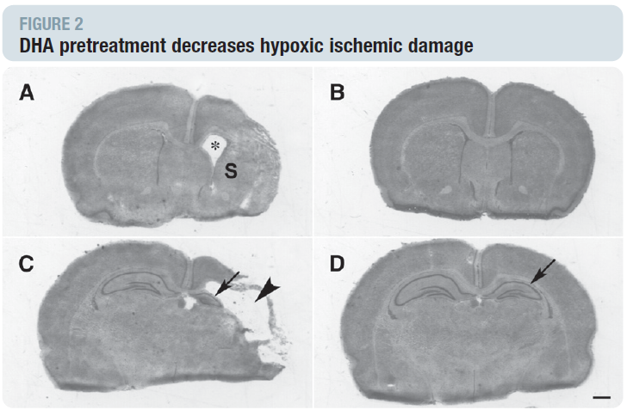
DHA Pre-treatment Protects the Brain in Animal Stroke Model
No DHA
With DHA
Control
Stroke
Control
Stroke
Berman et al . Am J Obstet Gynecol 2009; 200:305.e1–305.e6.

Slide 35
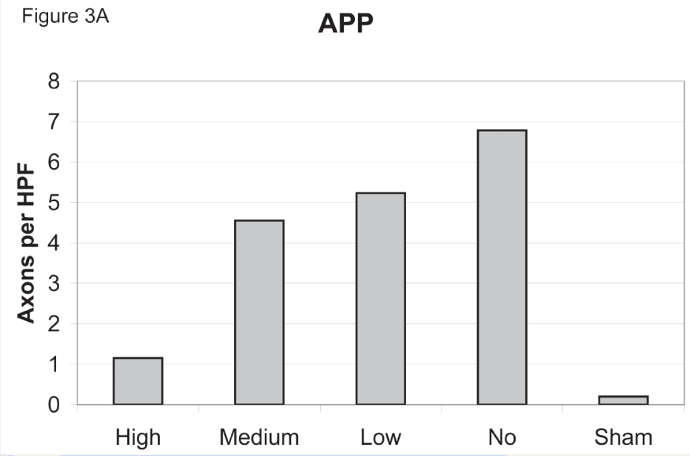

DHA Pre-treatment in Weight Drop Injury
Treatment with DHA for 30 days before head injury
Selective Density of Damaged Axon Nerve Cells
Morris Water Maze Times and Crossings
Injury
+
12 mg/kg
DHA
Injury
+
4 mg/kg
DHA
Injury
Injury
+
4 mg/kg
DHA
Injury
Injury
+
12 mg/kg
DHA
Injury
+
40 mg/kg
DHA
No
Injury
Injury
+
40 mg/kg
DHA
No
Injury
Bailes JE, Mills JD, Hadley K. Dietary Supplementation with the Omega-3 Fatty Acid DHA in TBI? Neurosurgery 2011.

Slide 36
Animal Models:
What about repair?

Slide 37
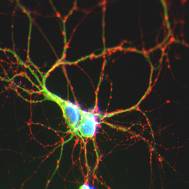
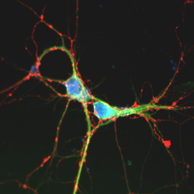
DHA Dietary Deficiency Impairs
Synapse Development
DHA Present
DHA Deficient
30 µm
Synapses in Hippocampal Neurons
Cao, HY Kim, et al. J. Neurochem. 2009

Slide 38
That’s great in the lab, but what about people?

Slide 40
How do we add “bricks” to help prevent TBI and/or repair the brain when injury does occur?

Slide 41
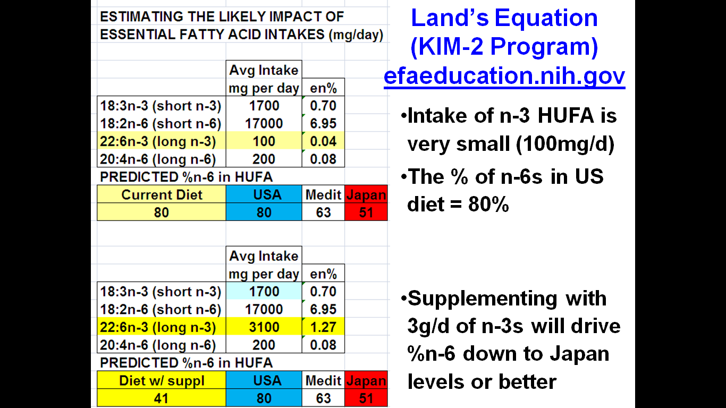

Slide 42


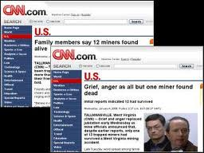


Sago Mine Disaster – Jan 2006
Omega 6:3

Slide 43
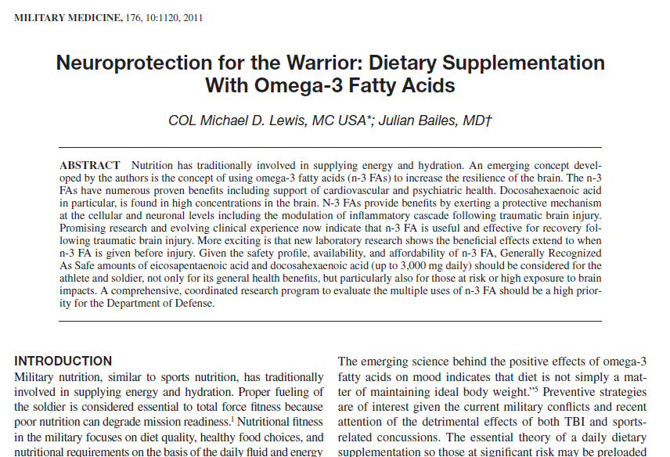

Slide 44
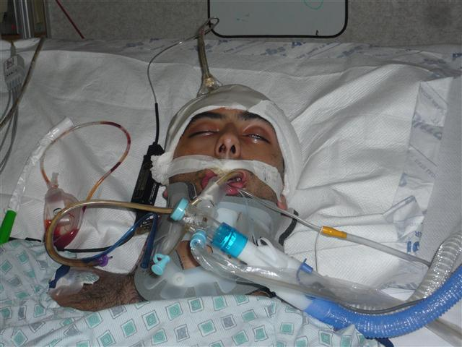

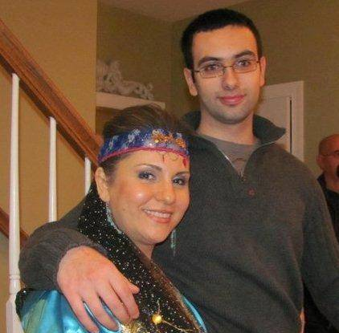
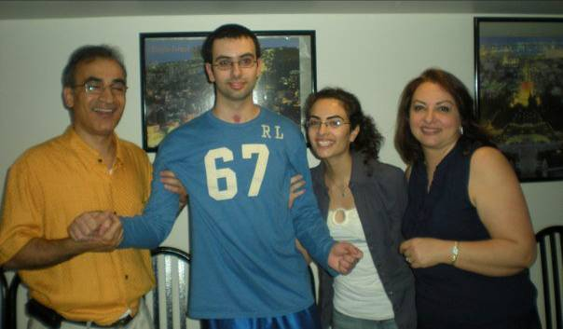
June 2010
May
March 2010
October 2010
July 2010
The story of Bobby
Lewis MD, Ghassemi P, Hibbeln JR. Therapeutic use of omega-3s in severe head trauma. Am J of Emergency Med, e-publ, Aug 2012

Slide 45

n-3s in Severe TBI: 15 ml twice a day (30ml/day);
9,756 mg EPA, 6,756 mg DHA, and
19,212 mg total n-3FA daily
Bobby, an 18-year old male survivor of a MVA. GCS=3, emergency neurosurgery, diffuse axonal injury, not expected to survive, started on high dose around day 10.

Slide 46
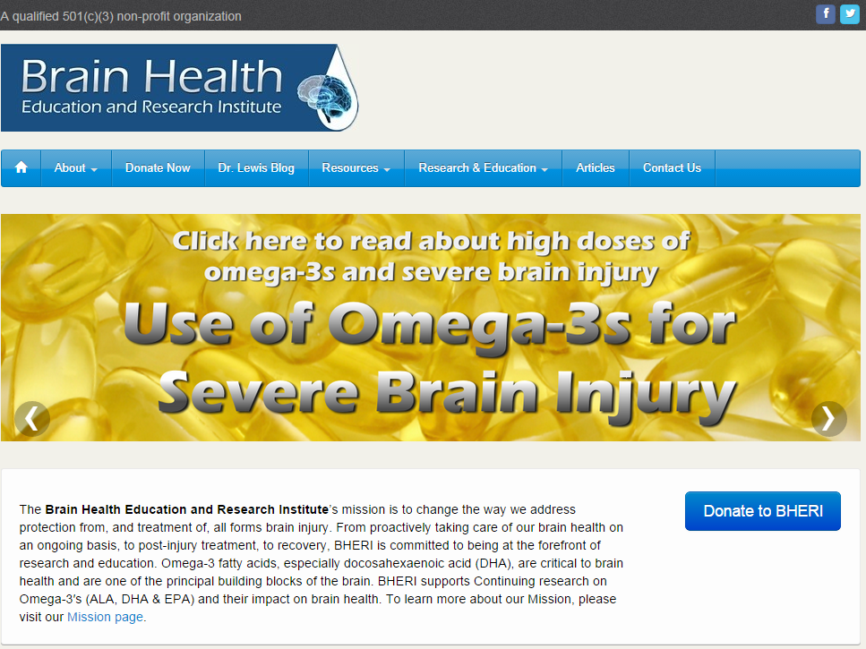

Slide 47
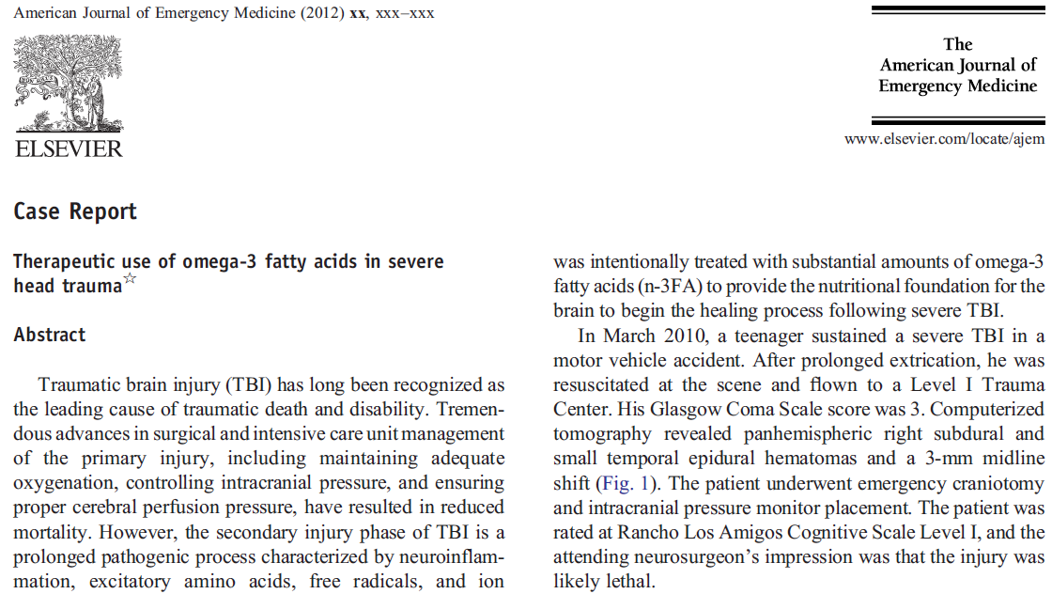

Slide 48


Slide 49






Concussions Dwarf # of Severe TBI

Slide 50

www.brainhealtheducation.org
www.brainhealtheducation.org/newsletter

Slide 51

“Omega-3 Protocol for Head Injury”
Using a concentrated omega-3 product:
1000 mg soft gel capsule with 600-900mg combined EPA and DHA – or 60-90% concentration in triglyceride form
One “dose” is 3000 mg EPA+DHA (3-5 capsules)
Three times a day for one week (9000 mg)
Two times a day the next week (6000 mg)
Once a day as ongoing maintenance dose (3000 mg)

Slide 52

Personal Clinical Experience

Slide 53
Summary
TBI: diverse heterogeneity remains a clinical challenge
Pharma has focused on narrow enzymatic targets in the secondary pathogenesis
N-3FA are broad holistic approach that can impact neuroprotection, neuroinflammation, and neuroregeneration
Saturating brain of TBI patients w/ n-3FA can help, is safe and well-tolerated, even for prolonged periods
Used by thousands of people around the world
In use by dozens of university athletic programs

Slide 54
Summary
There are no magic pills or cures for TBI and there never will be
Once an injury occurs, we are left with trying to optimize the environment to give a patient the best opportunity to regain as much function as possible
Finding and testing safe, viable, effective modalities like omega-3s is imperative
More research is needed!

Slide 55
PARADIGM SHIFT:
Therapeutic amounts of omega-3 for TBI are a log scale greater than what is used for nutrition

Slide 56

A functional medicine approach to brain health
7811 Montrose Rd #215
Potomac, MD 20854
www.BrainCARE.center
info@BrainCARE.center
(240) 398-3481 (o)
(240) 398-3482 (f)

Slide 57

Do you wonder what strategies might be used to prevent brain injury or help the healing process?
Dr. Lewis has answers.
He pioneered new therapies for the US military.
Now these strategies are available in his new book.
Available on Amazon.com

