Slide 1
CBD and the Brain
Michael Lewis, MD, MPH, MBA, FACPM, FACN
Colonel (Retired), U.S. Army
a 501(c)(3) nonprofit organization
BIAMD – March 2017

Slide 2
What do these men have in common?
Aiden Hampson, a neuropharmacologist at the Natl Inst for Mental Health (NIMH). Now Health Science Administrator, Natl Inst of Drug Abuse (NIDA), Medications Research Grants Branch
Julius Axelrod (1912-2004), Professor Emeritus, NIH, pharmacologist and neuroscientist who shared the 1970 Nobel Prize in Physiology or Medicine for his discovery of the actions of neurotransmitters in regulating the metabolism of the nervous system
Maurizio Grimaldi, professor of neurology/ neuropsychopharmacology and toxicology, NIMH. Now with Natl Inst on Aging, Scientific Review Branch

Slide 4
Like THC, cannabidiol (CBD) is a natural component of the marijuana plant, Cannabis sativa, although unlike THC, CBD does not activate cannabinoid receptors and so is devoid of psychoactive effects (12). This study reports that CBD and other cannabinoids such as THC are potent antioxidants that protect neurons from glutamate-induced death without cannabinoid receptor activation.
The nonpsychoactive marijuana constituent CBD was found to prevent both glutamate neurotoxicity and ROS-induced cell death. The psychoactive principle of Cannabis, THC, also blocked glutamate neurotoxicity with a similar potency to cannabidiol.

Slide 5
US Govt: Who’s Right about Cannabis?
FDA & DEA
HHS - NIH
Schedule I Drug:
(a) high potential for abuse;
(b) no currently accepted medical use;
(c) lack of accepted safety for use of the drug or other substance under medical supervision
Holds a patent for CBD:
Neuroprotectant, anti-epileptic, anxiolytic
“For use in prophylaxis and treatment of disease”
“Particular application as neuroprotectants”
“No signs of toxicity or serious side effects have been observed following chronic administration… even when given in large acute doses”

Slide 6
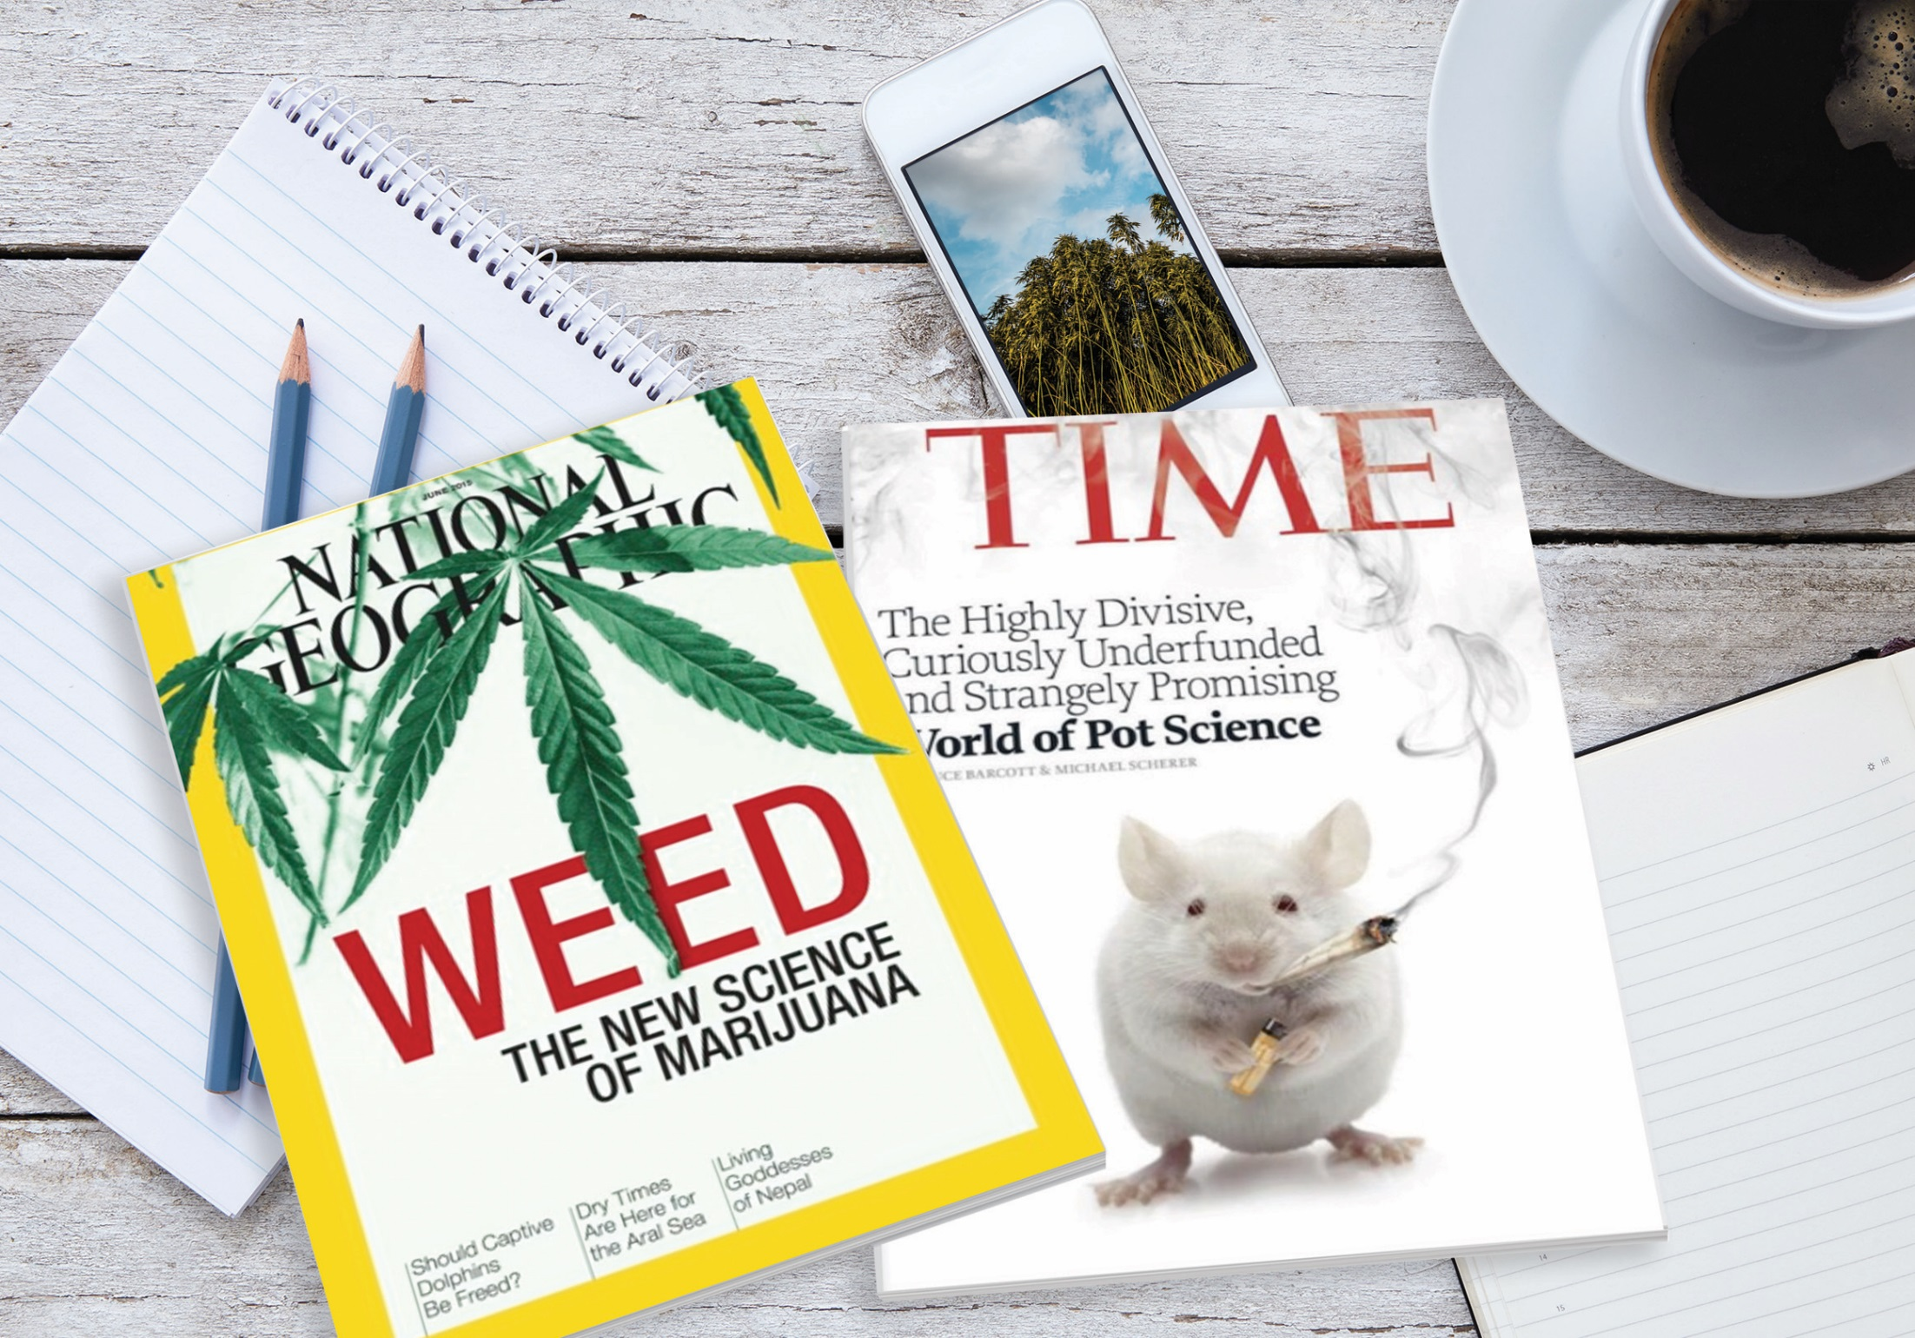

Slide 7
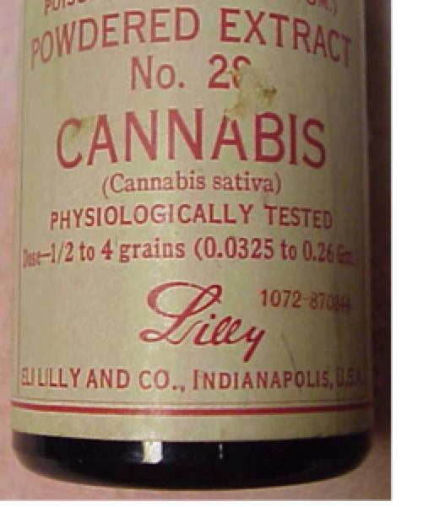
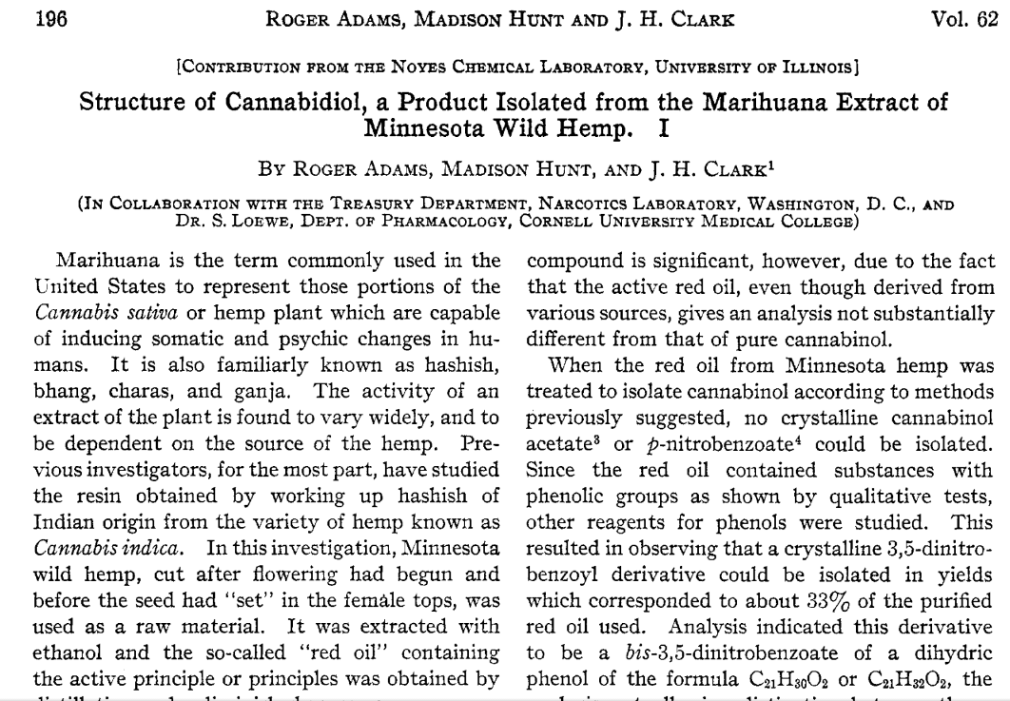
History of Cannabis Suggests Safety
Promoted as analgesic, sedative, anti-inflammatory, antispasmotic, and anticonvulsant properties
Available in 1906 Mfg by Eli Lilly, Wyeth Park-Davis, Sharp & Dohme

Slide 8
Cannabis sativa
Hemp
THC content <0.3%
Cultivated like bamboo: tall, thick, fast growing
Grown outside >20 ft
Classified as food, legal to import into U.S.
Use: Foods, oils, textiles, rope, fabrics
Marijuana
THC content 5-30%
Cultivated for THC from budding flowers
Grown under controlled conditions
Classified as illegal drug
Use: Recreational/
medical drug

Slide 9
Comparing Hemp to Medical Cannabis
Outdoor Grown
Agricultural Hemp
Sequesters CO2
Environmentally Helpful
Requires 80% less water
Sun Powered Outdoor Grow
No artificial light Sources required
Textbook Sustainability
Indoor Grown
Medical Cannabis
Enormous Carbon Foot Print
Environmentally Harmful
Wasteful Water Demands
Huge Strain on Power Grid
Consequences of Fungicides, Pesticides and Fertilizers
Unsustainable

Slide 10
Endocannabinoid System (ECS) Triad
Cannabinoid Receptors
CB1, CB2, TRPV1, 5-HT1A
Endogenous
Cannabinoids
[Anandamide (AEA)
2-arachidonoylglycerol (2-AG)]
Regulatory Metabolic/
Catabolic Enzymes
[fatty acid amide hydrolase (FAAH), monoacylglycerol lipase (MAGL), and others]

Slide 11
Endocannabinoid Tone
Most important physiologic system involved in establishing and maintaining human health
Various lifestyle factors including diet and aerobic activity affect the overall ECS function or ‘endocannabinoid tone’
Endocannabinoid tone is a function of:
Density of cannabinoid receptors,
Their functional status (up/down-regulated)
Relative abundance or dearth of endocannabinoids

Slide 12
Balanced Effects of Endocannabinoids
Migraines
Chronic pain
Fibromyalgia
IBS
Depression
PTSD
Hyperactive/
Too much stimulation
Ideally, if the ECS is functioning normally, a person might enjoy a normal mental state, without pain, have good digestive function, etc.
Metabolic syndrome
Obesity & over-eating
Increased inflammation
Insulin resistance/diabetes
Mental health instability
Clinical
Endocannabinoid
Deficiency

Slide 13
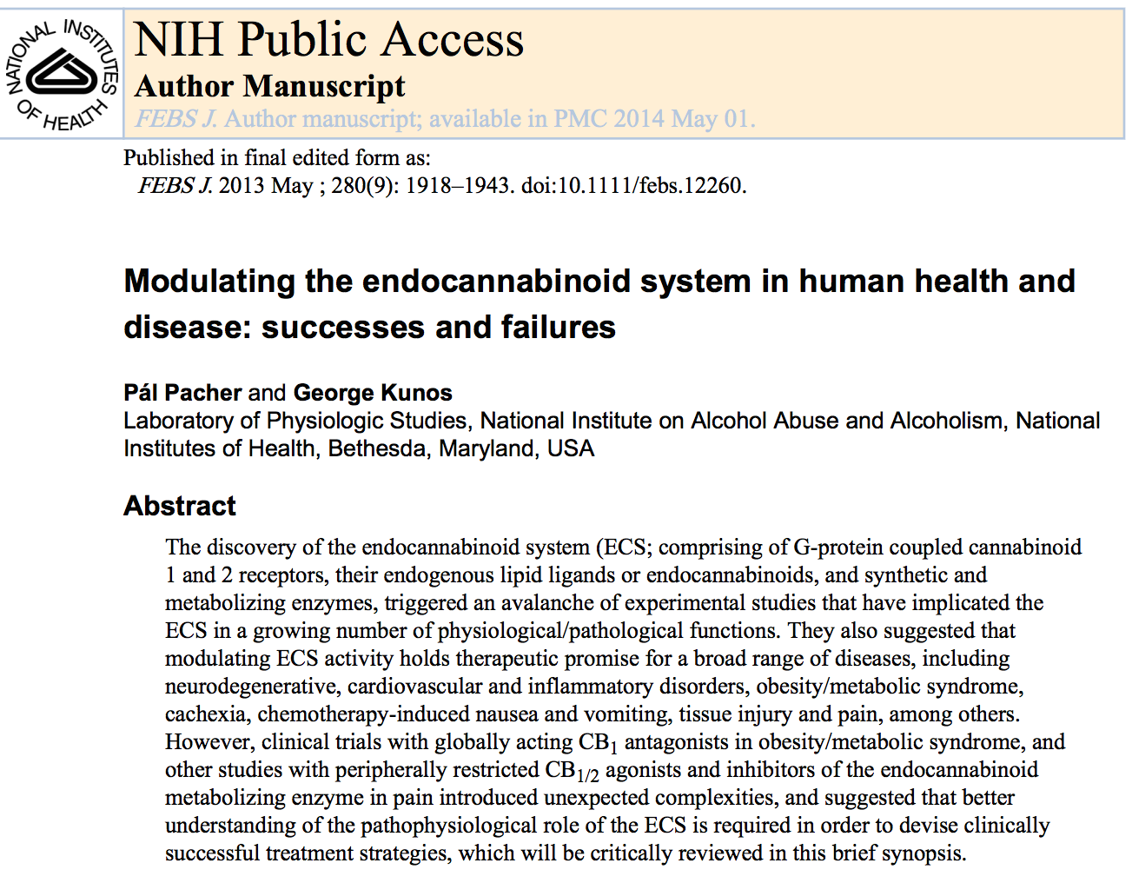

Slide 14
We All Have Cannabinoid Receptors

Slide 15
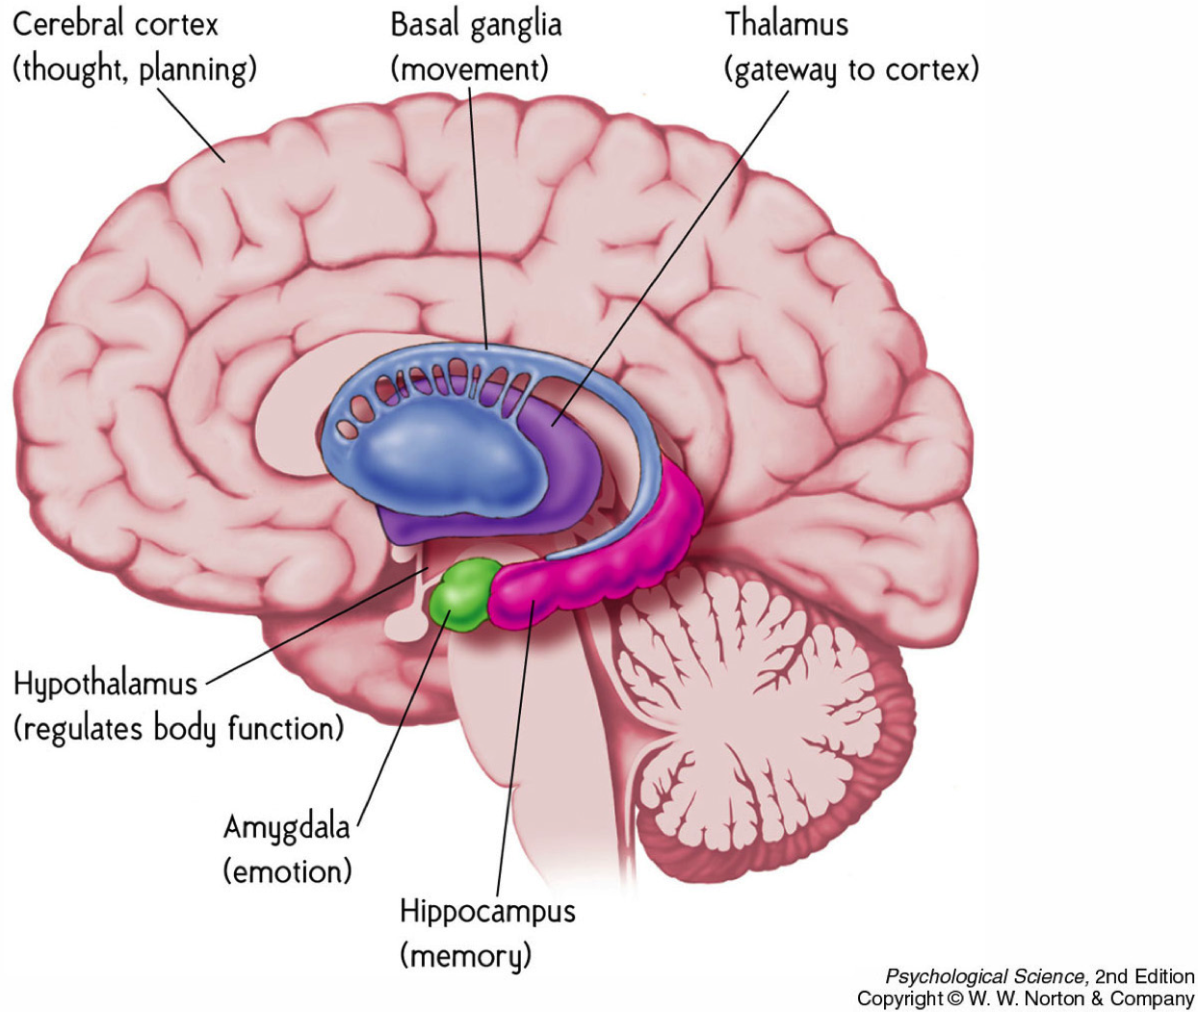
CB1
CB1
CB2 Receptors CB2A in brain
(Microglia)
CB2B in periph
CB1
CB1
CB1
CB1
CB1
CB1
CB1
CB1
CB1
Cerebellum
(coordination & balance)
CB1
CB1
Medulla oblongata
(cardio-resp fxn)

Slide 16
Influence of Cannabinoid System
Modulate neurotransmitter release in a manner that prevents excessive neuronal activity (thus calming and decreasing anxiety)
Reduces pain and inflammation
Regulates movement and posture control
Regulates sensory perception, memory, and cognitive function

Slide 17
Endocannabinoid System
Presynaptic
Neuron
Endocannabinoids released from post-synaptic neuron bind to CB₁ receptors in the pre-synaptic neuron
Cause reduction in GABA & glutamate release
Cause increase in serotonin
CB1 Receptors
5HT
5HT
AEA
2AG
Postsynaptic
Neuron

Slide 18
Nature and the Endocannabinoid System
Cannabinoid Receptors
[CB1, CB2, TRPV1, 5-HT1A]
Phyto-Cannabinoids
[THC & CBD]
Endogenous
Cannabinoids
[Anandamide (AEA)
2-arachidonoylglycerol (2-AG)]
Regulatory Metabolic/
Catabolic Enzymes
[fatty acid amide hydrolase (FAAH), monoacylglycerol lipase (MAGL), and others]

Slide 19
Endocannabinoids
(AEA)
Phytocannabinoids

Slide 20
What is Difference Between THC & CBD?
Tetrahydrocannabinol (THC)
Psychoactive or “high”
Mimics anandamide
Anxiogenic
Paranoia potential
Stimulates appetite
Sleep inducing
Legal status ?’s
Cannabidiol (CBD)
Non-psychoactive
Counters THC effects
Anxiolytic
Anti-psychotic
Decreases appetite
Promotes wakefulness
Hemp is food

Slide 21
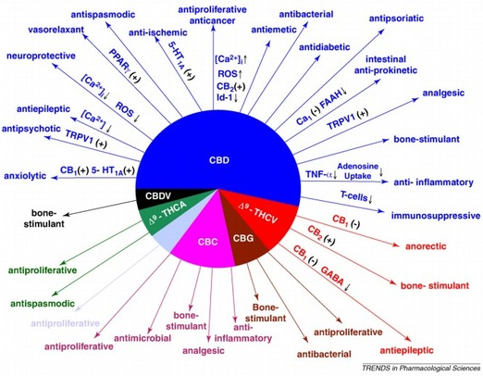

Slide 22
CBD: Preclinical and Clinical Evidence
Anti-Seizure Effects: Elimination or decreased frequency of seizures
Neuroprotective and Anti-Inflammatory Effects: Alzheimer’s, stroke, glutamate toxicity, multiple sclerosis, Parkinson’s disease, and neurodegeneration caused by alcohol abuse
Analgesic Effects: Efficacy on central and peripheral neuropathic pain, rheumatoid arthritis, and cancer pain
Anti-Tumor Effects: Antioxidant/anti-inflammatory effects
Anti-Psychotic Effects: May mitigate, particularly induced by THC
Efficacy for Treating Substance Use Disorders: Reduced rewarding effects of morphine and reduced cue-induced heroin seeking
Anti-Anxiety, Stress Reduction Effects: Reducing behavioral and physiological measures of stress and anxiety

Slide 23
CBD has powerful anti-anxiety properties
Panic disorder
Obsessive Compulsive Disorder (OCD)
Social phobia
Post-Traumatic Stress Disorder (PTSD)
Generalized Anxiety Disorder (GAD)
Mild to moderate depression

Slide 24
Symptoms Following Brain Injury

Slide 26
How CBD Treats Anxiety (Mechanisms)
Serotonin 5-HT1A receptor (partial agonist)
CBD (but not THC) binds to receptor, but only stimulates partially
Displaces agonists in dose-dependent manner
Results in increased serotonin, dopamine
Hippocampal neurogenesis
Stimulation of CB1/CB2 receptor sites upregulates endocannabinoid signaling leading to growth
Blocks FAAH enzyme from breaking down anandamide increasing its levels in the brain

Slide 27
Safety of CBD
…despite its molecular similarity to THC, CBD only interacts with cannabinoid receptors weakly at very high doses (100 times that of THC), and the alterations in thinking and perception caused by THC are not observed with CBD. The different pharmacological properties of CBD give it a different safety profile from THC.
A review of 25 studies on the safety and efficacy of CBD did not identify significant side effects across a wide range of dosages, including acute and chronic dose regimens, using various modes of administration. CBD is present in nabiximols which, as noted earlier, is approved throughout most of Europe and in other countries. Because of this, there is extensive information available with regard to its metabolism, toxicology, and safety.
Nora D. Volkow, Director, National Institute on Drug Abuse
Testimony on June 24, 2015, to Senate Caucus on International Narcotics Control

Slide 28
My Clinical Experience w/ CBD
Limited experience to date
Clinical practice focused on helping people recover from TBI/concussions
Very effective for anxiety and depression
Concentrated 15mg gelcaps once/twice a day and as needed throughout the day
Overdoing it is possible creating anxiety

Slide 29
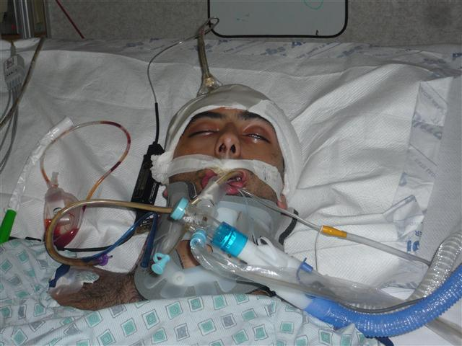
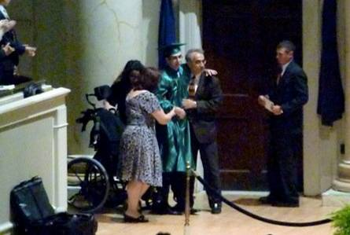
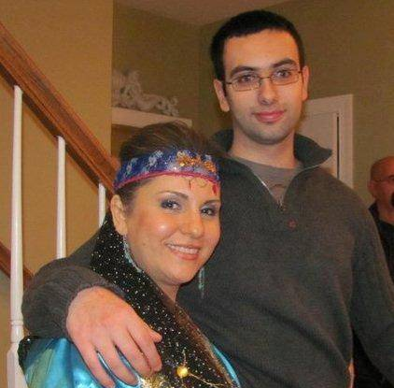
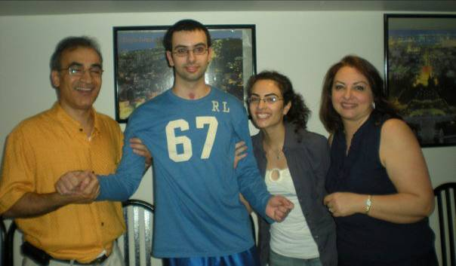
June 2010
May
March 2010
October 2010
July 2010
The story of Bobby
Lewis MD, Ghassemi P, Hibbeln JR. Therapeutic use of omega-3s in severe head trauma. Am J of Emergency Med, e-publ, Aug 2012

Slide 30
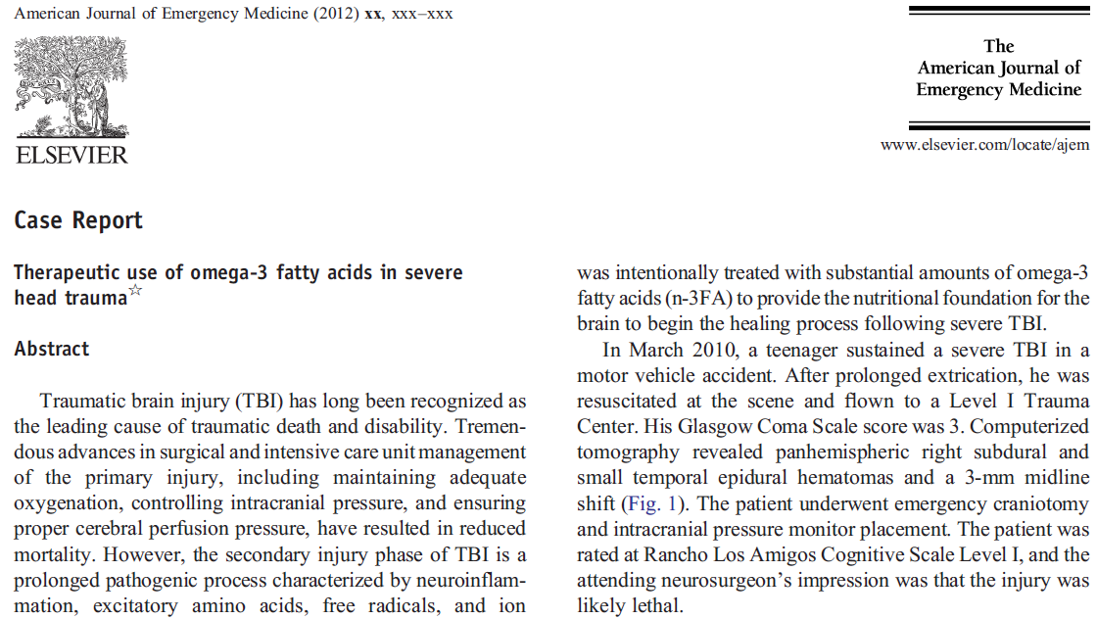

Slide 32
Update on Bobby
Started on hemp-derived CBD oil June 2015
Phone call two weeks later….
No longer depressed
Stopped taking SSRI’s
Anxiety levels completely vanished
Asked a girl for her phone number
Set goal to walk without assistance
10 months later, an email…

Slide 34
Summary: How CBD Helps in Anxiety
Rule #1: low doses – start low and gradually ↑
High doses may overwhelm CB1 receptors and ↑spaciness and anxiety
Very safe: no receptors in Respiratory & C-V nuclei
Increases hippocampus neurogenesis
Interaction with the Limbic system: stress, anxiety , fear, emotions
Activation of HPA axis to decrease corticosteroid production via amygdala (CRH)-pituitary (ACTH)-adrenals (cortisol)

Slide 35
The American people are the ultimate owners of U.S. Patent 6,630,507 B1 [Cannabinoids as Antioxidants and Neuroprotectants] that the USG holds for us

Slide 36
Summary
Cannabis has a long tradition in the healing arts
The Endocannabinoid system plays a central role in most biological systems
Is well tolerated and has a calming effect
Could become a useful tool for a range of psychiatric disorders in the future including those as a result of TBI

Slide 37
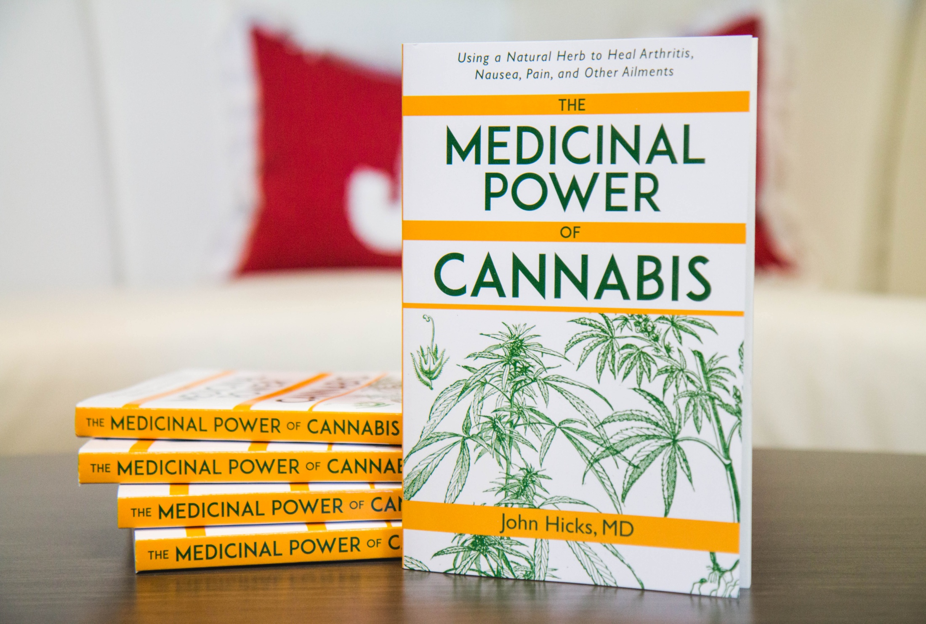
^{GW PHARMACEUTICALS:}
READ THIS BOOK:
“The Medicinal Powers Of Cannabis”
By John Hicks, MD
BEST CANNABIS PLAY AND A RENEWED BUY AFTER Q4 RESULTS
Available At
GreenHealthCube.com

Slide 38
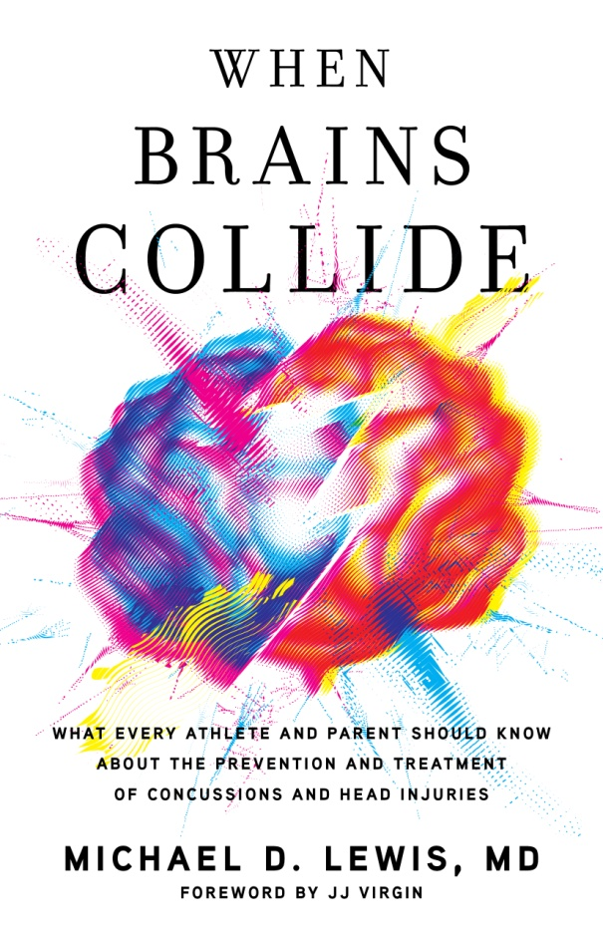
Do you wonder what strategies might be used to prevent brain injury or help the healing process?
Dr. Lewis has answers. He pioneered new therapies for the US military. Now these strategies are available in his new book.
Available on Amazon.com

